Slide 2
Impact Consulting Fellowship
CENTER FOR SOCIAL VALUE CREATION
Community Forklift - Final Deliverable
December 15th, 2023

Slide 3
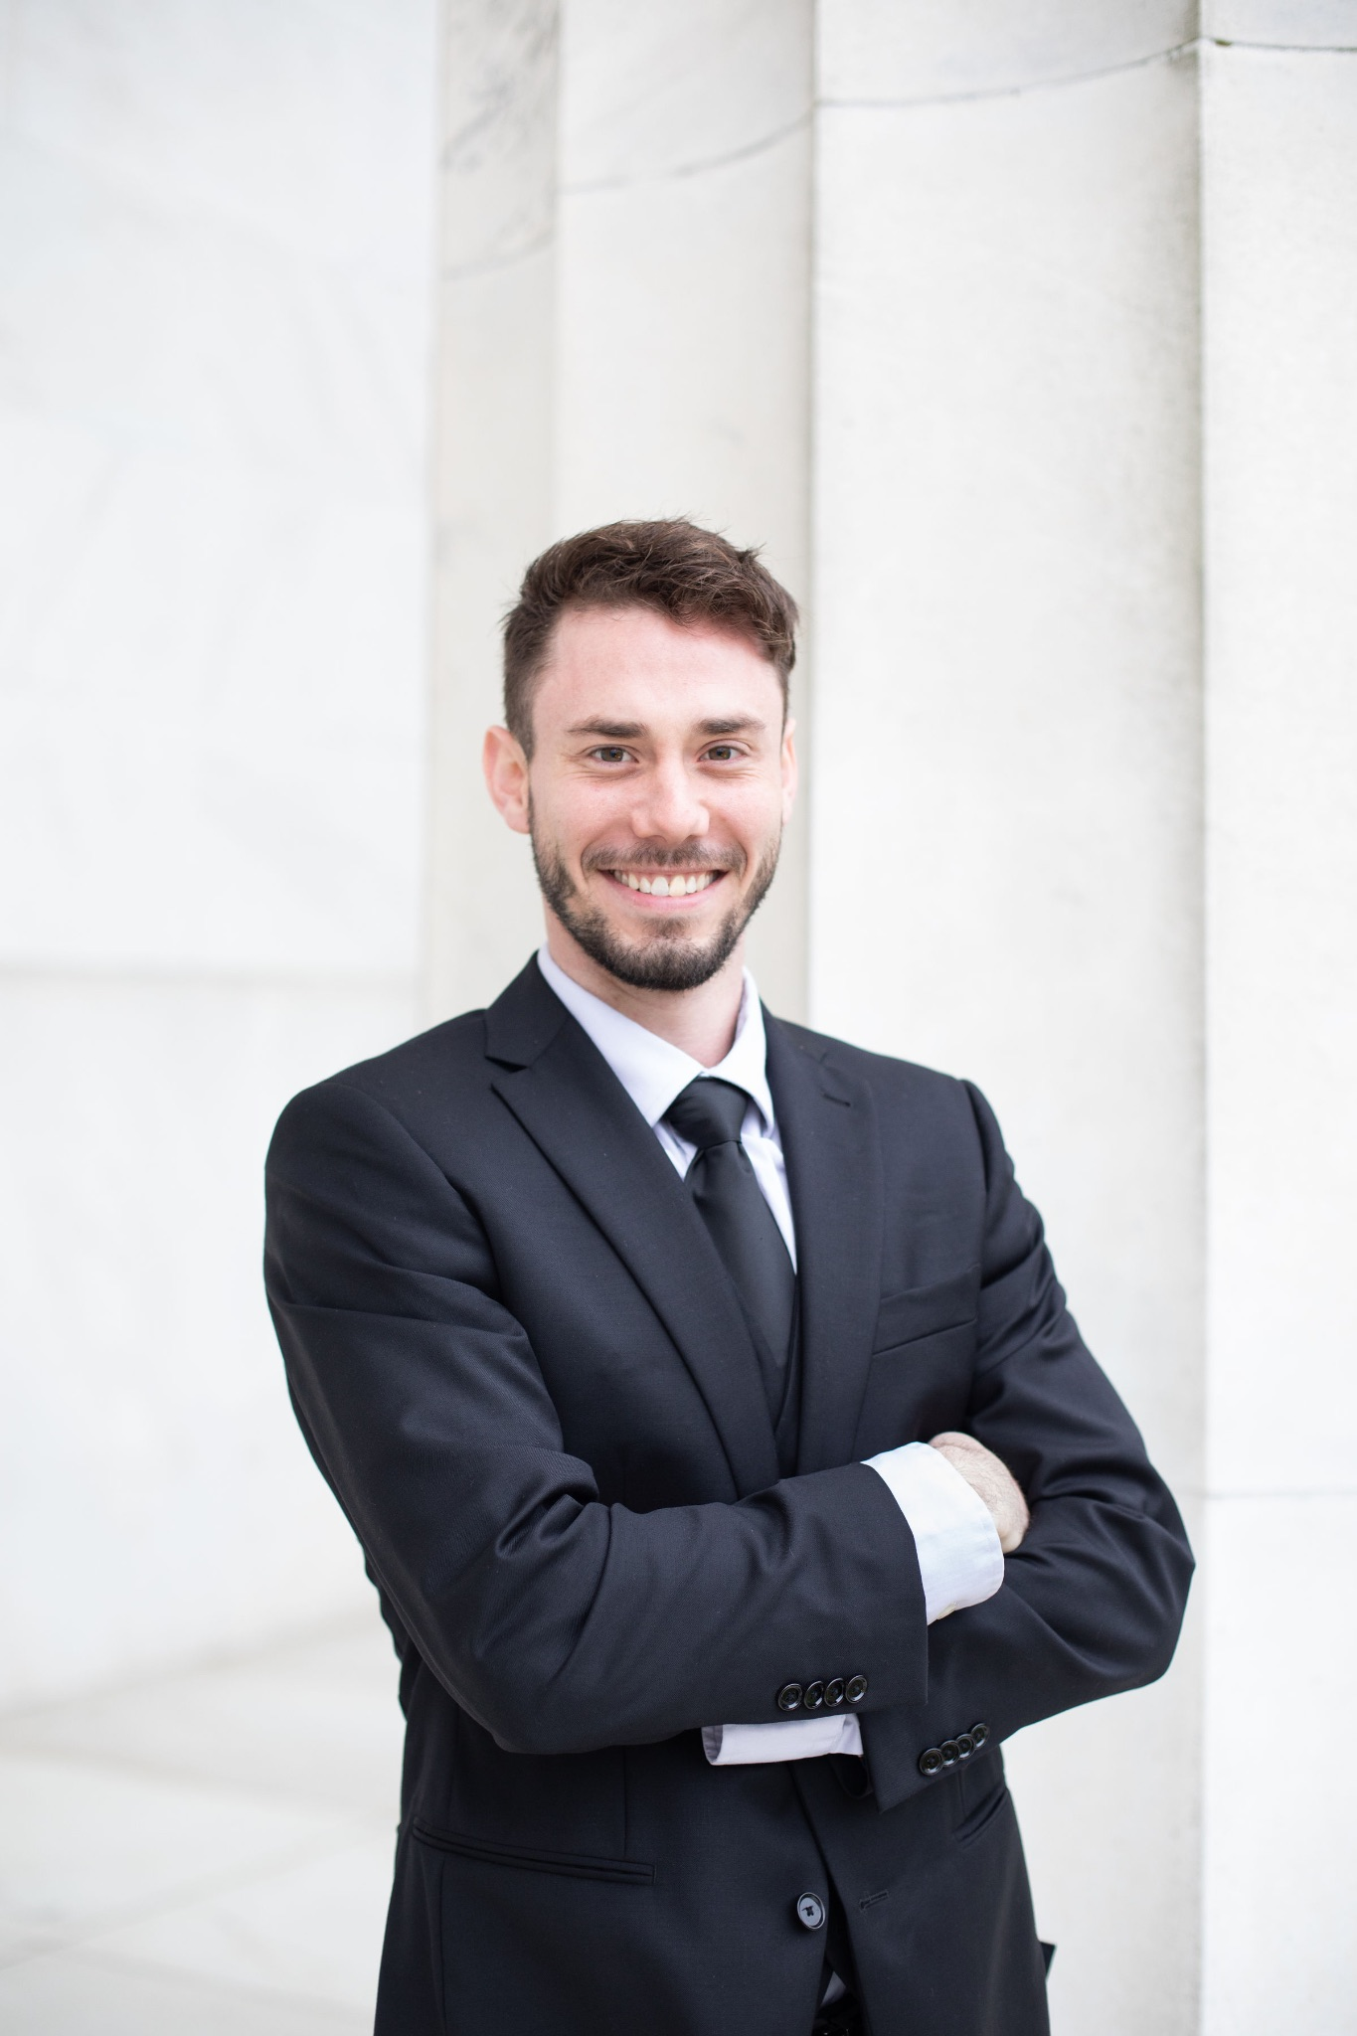
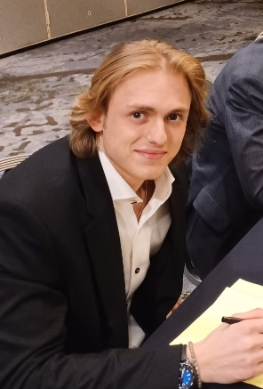
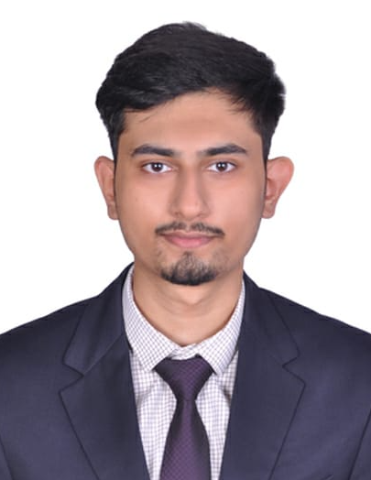
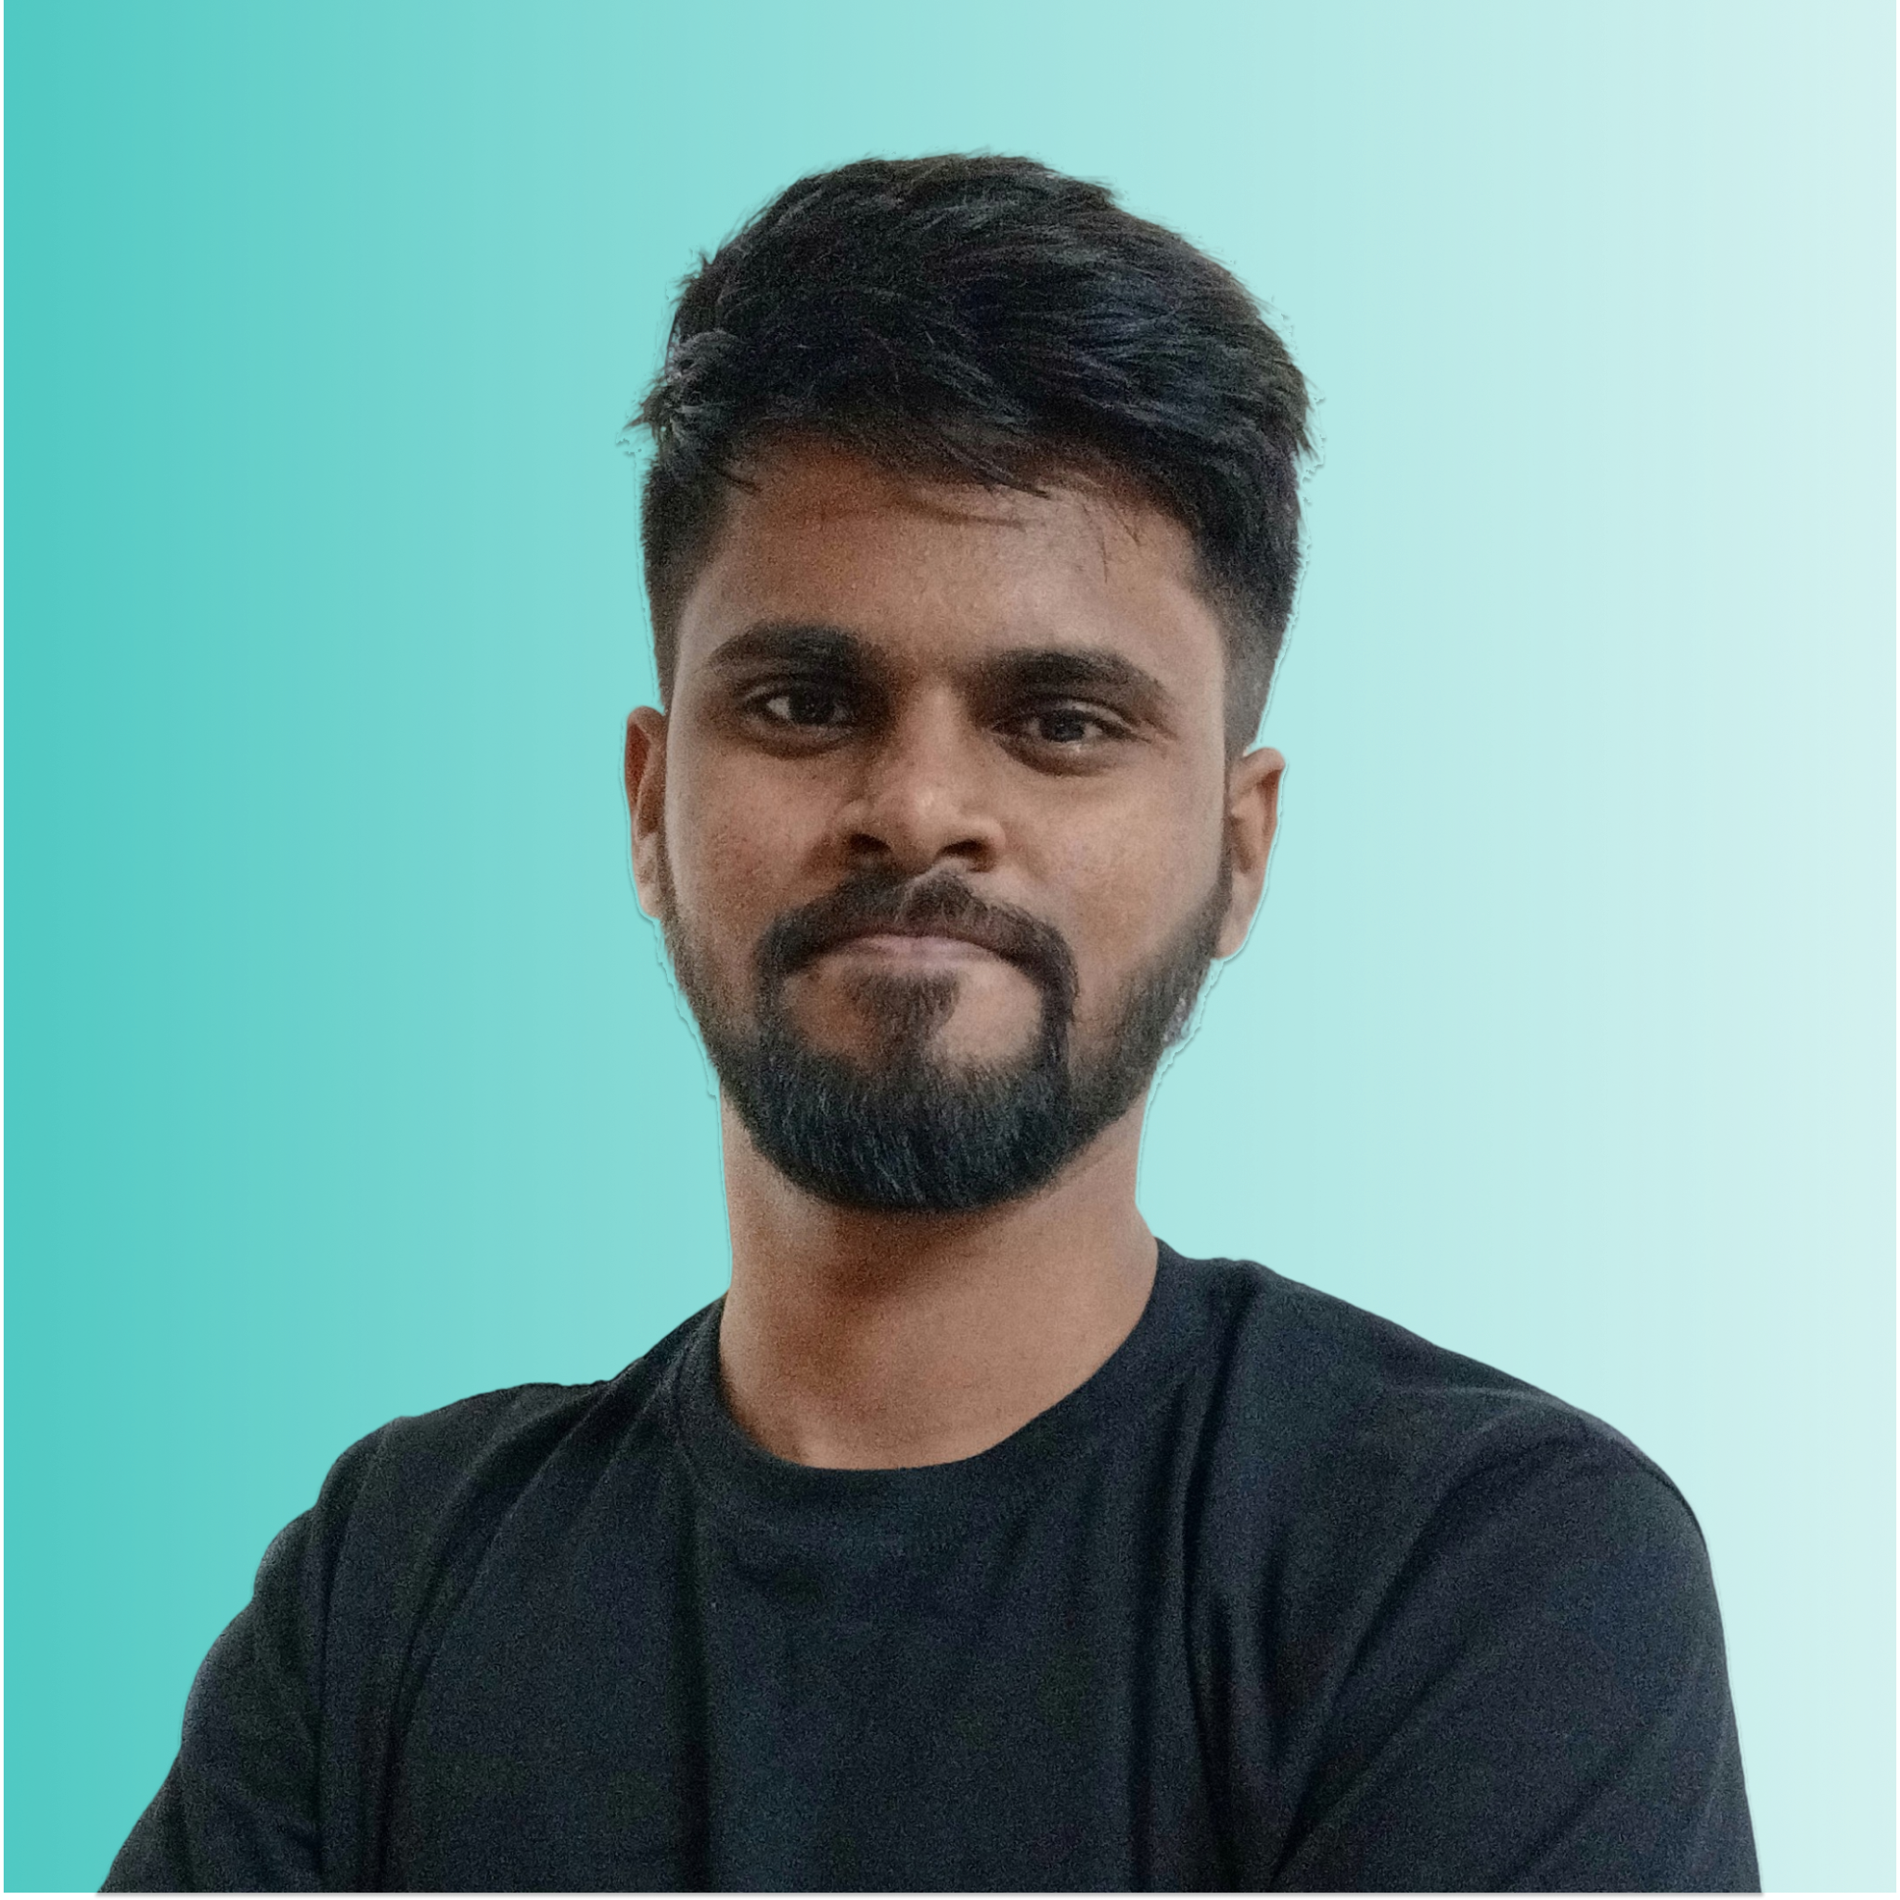
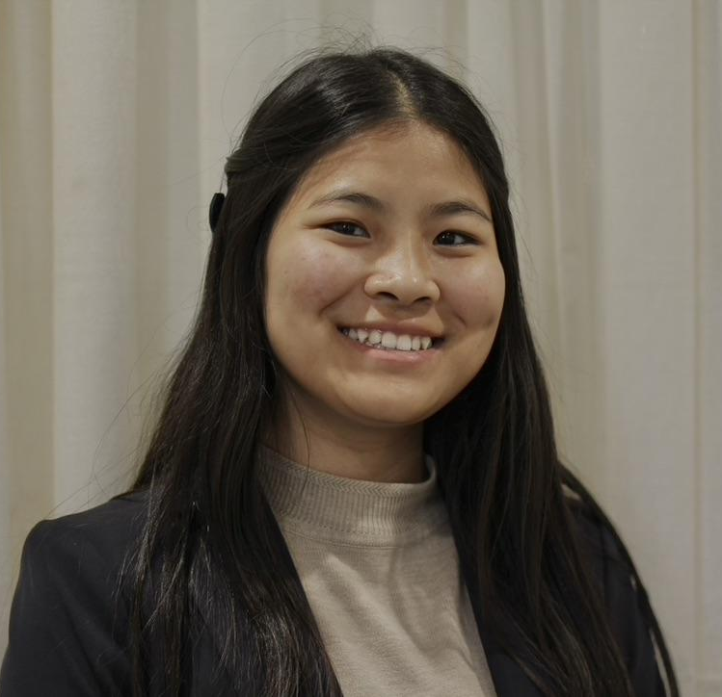
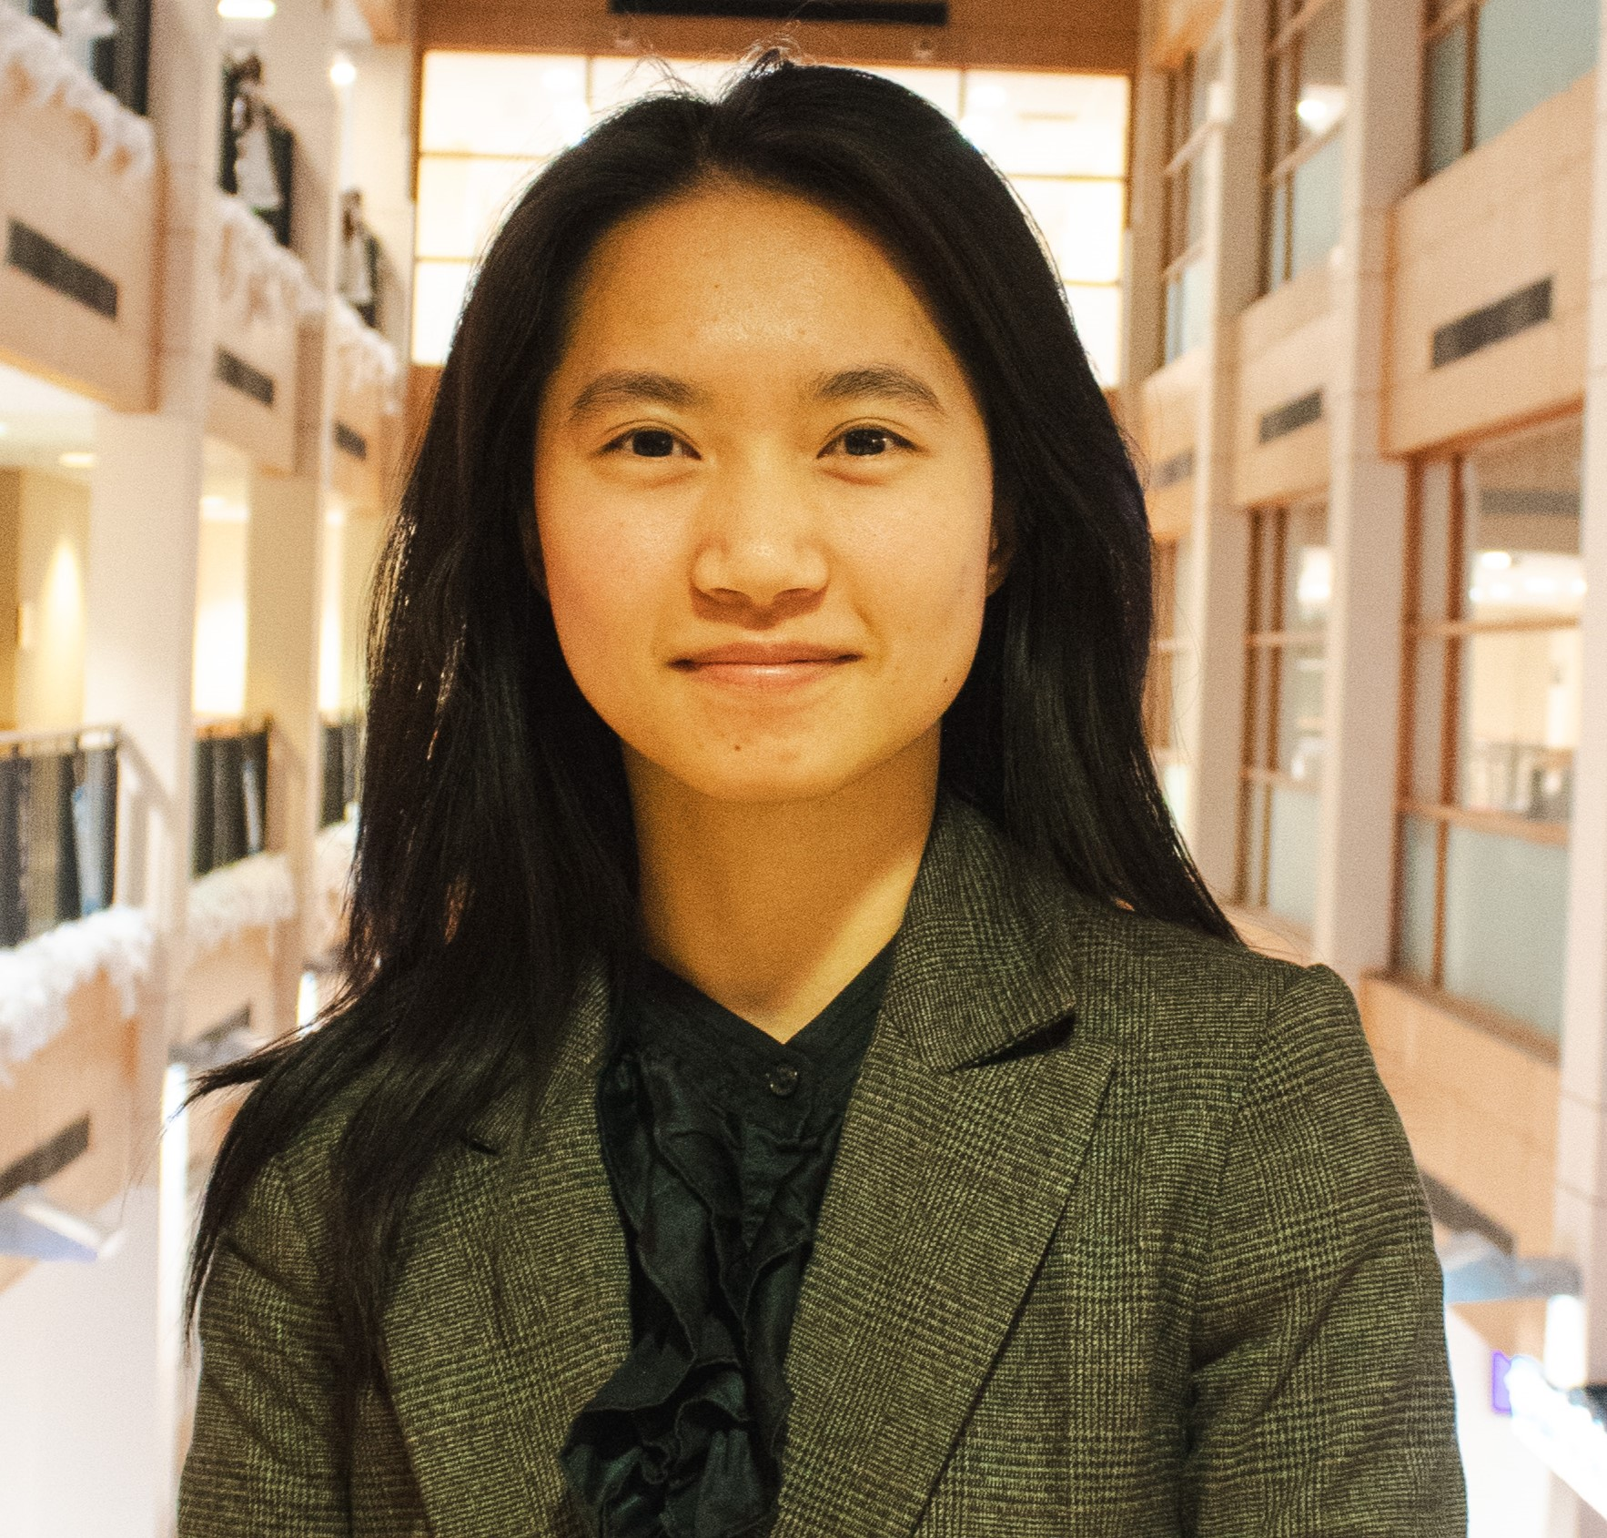
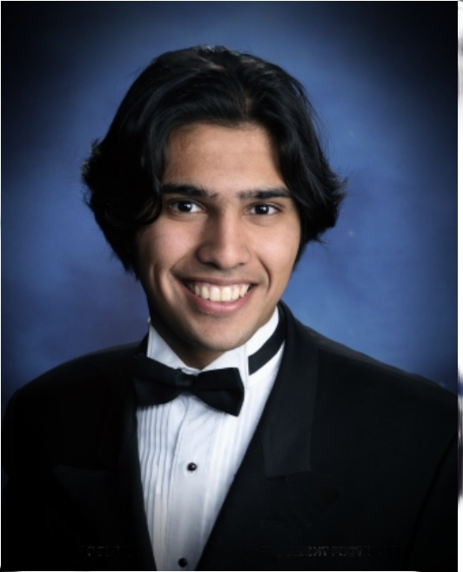
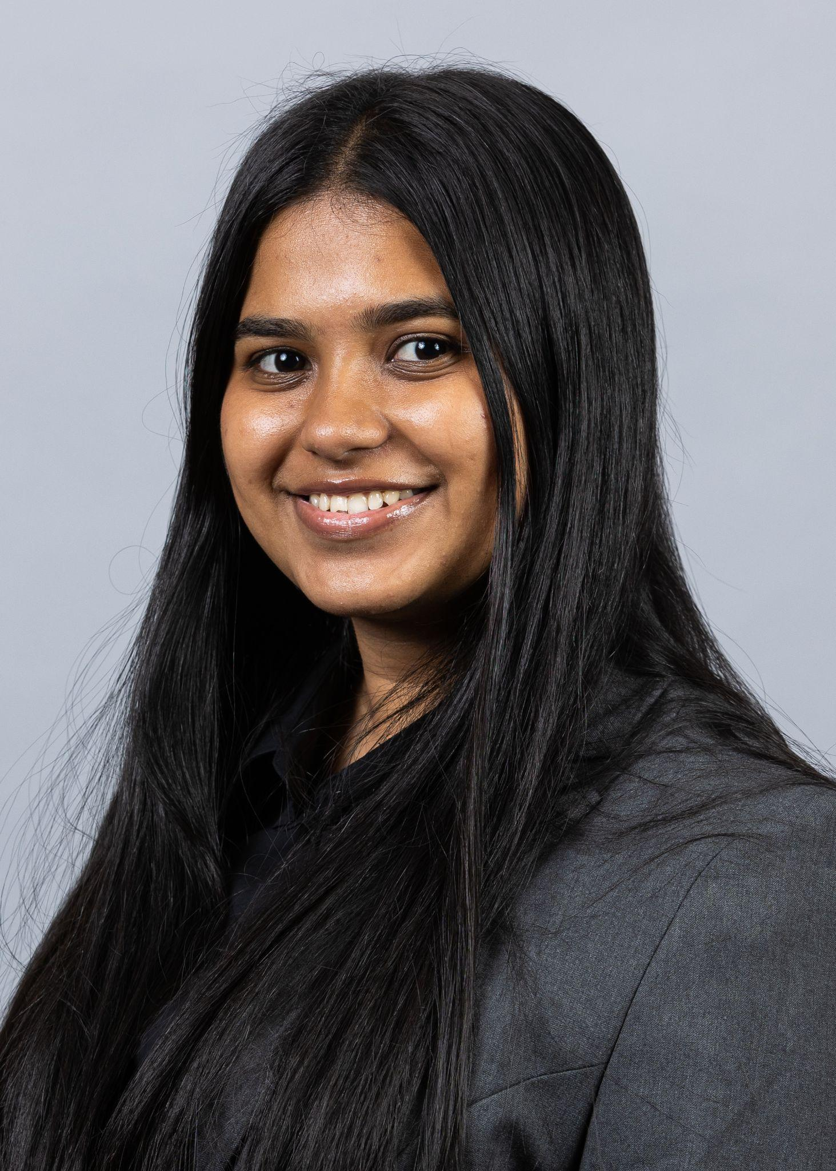
Meet the Team
Peter Cassell
Harshil Patel
Dimitri Sfakiyanudis
Alexandra Doncheva
Rutwik Patil
Ashish Salunkhe
Kim Lek
Julia Huang
Mohnish Mahajan
Tanvi Murumkar

Slide 4
Goal
To make Community Forklift a powerhouse of reuse and to help lead the reuse and waste management conversation in the DMV.

Slide 5
Thesis
An Organized Warehouse that can Process What It Receives, that Proactively Engages and Partners With Others, that Prices Well will lead the charge that Enables the DMV to Become The Hero of reuse and waste management.

Slide 6
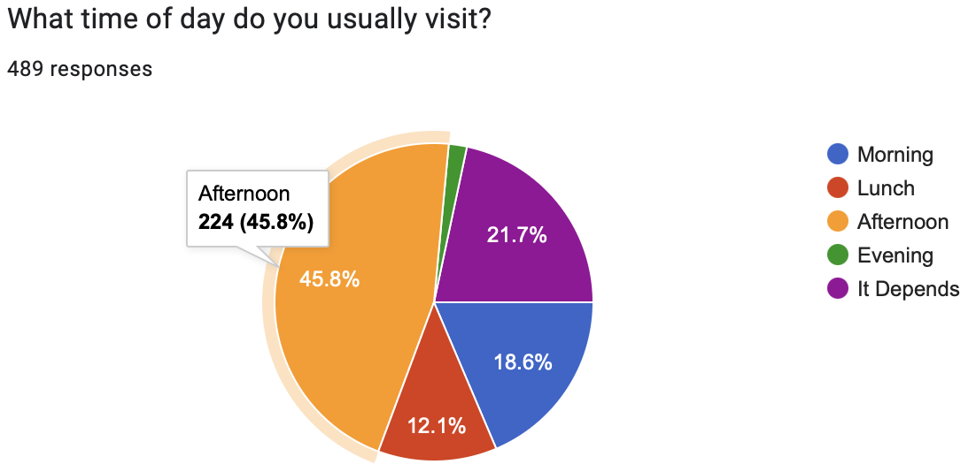
An Organized Warehouse that can Process The Intake It Receives
+Reduce Donation Hours
-Saturday/Sunday: 10am to 12pm & 1pm to 4pm
-Monday to Friday: 1pm to 4pm

Slide 7
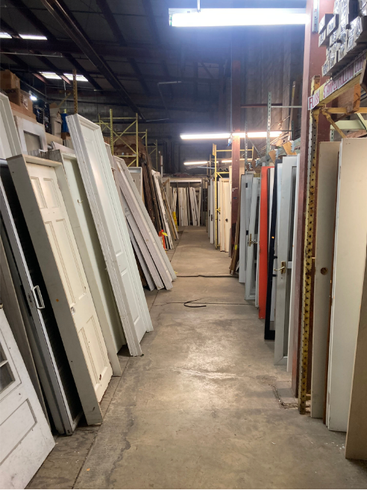
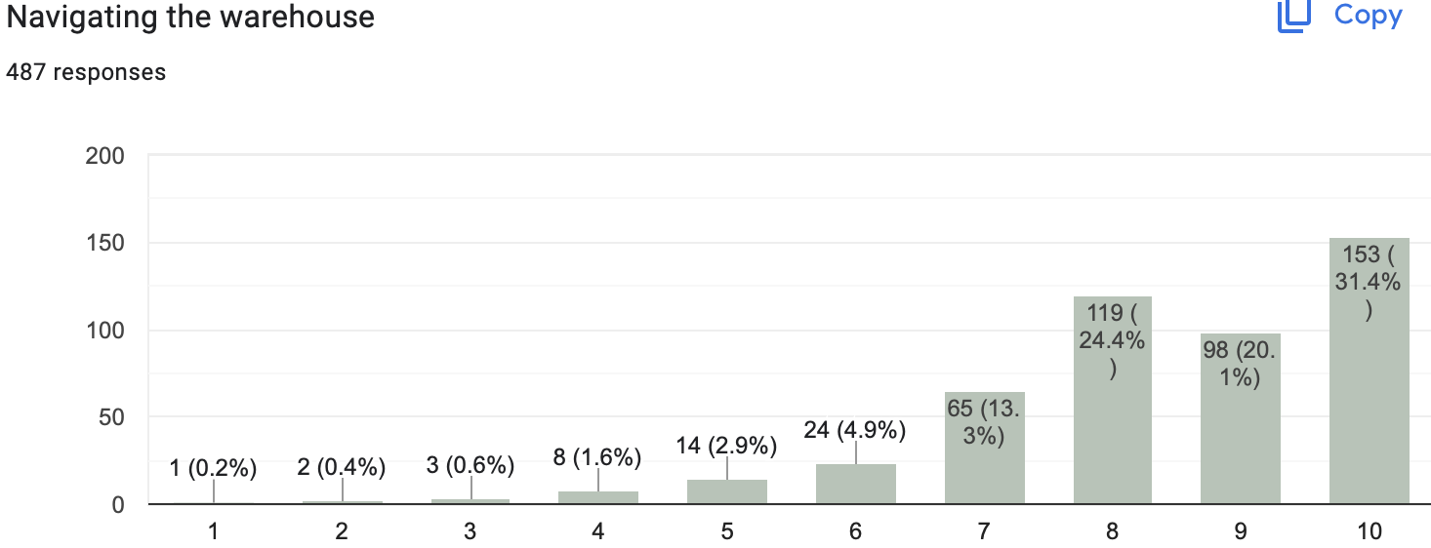
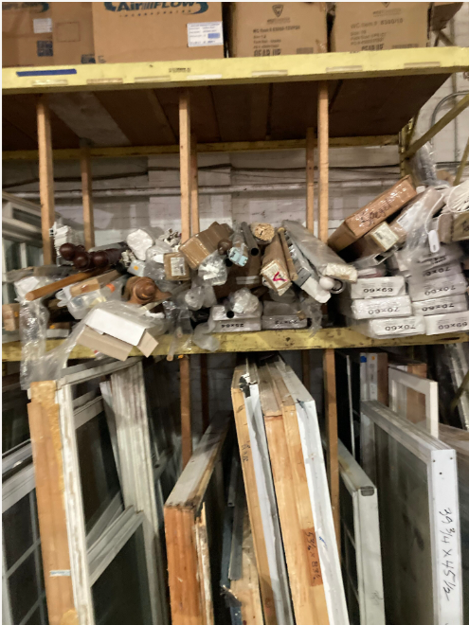
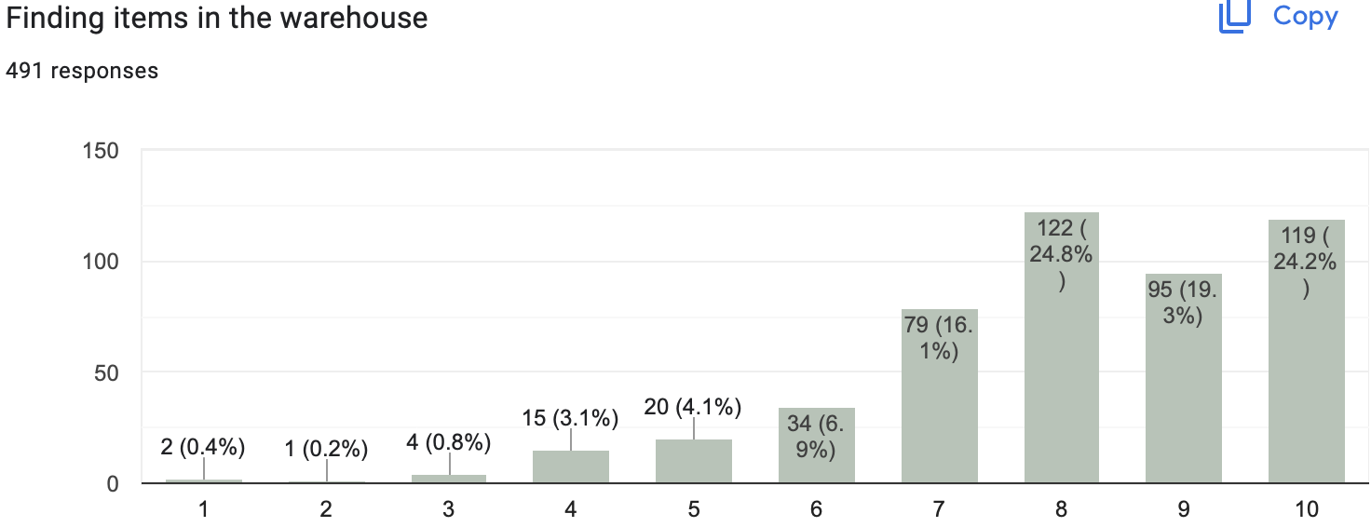
An Organized Warehouse that can Process The Intake It Receives

Slide 8
An Organized Warehouse that can Process The Intake It Receives
-Assign sections to crew members
-Create trainings for crew members
-Make an ideas jar

Slide 9
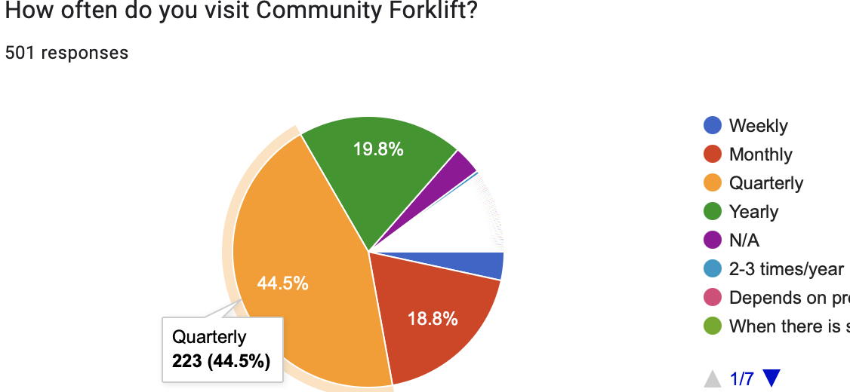
That Proactively Engages and Partners with Others
Social Media:
Educational content on social (30 secs - 60 sec)
Do DIY projects with warehouse items to teach and generate hype
Behind-the-scenes
New arrivals Influencer to promote (to younger audience)
Affiliate links
Very proactively approach DMV reuse and waste management
Contact the 15 mile radius of potential partners
Outreach:
Drive around to give them the flyers
Interview customers Quarterly to ask what they like about the place

Slide 10
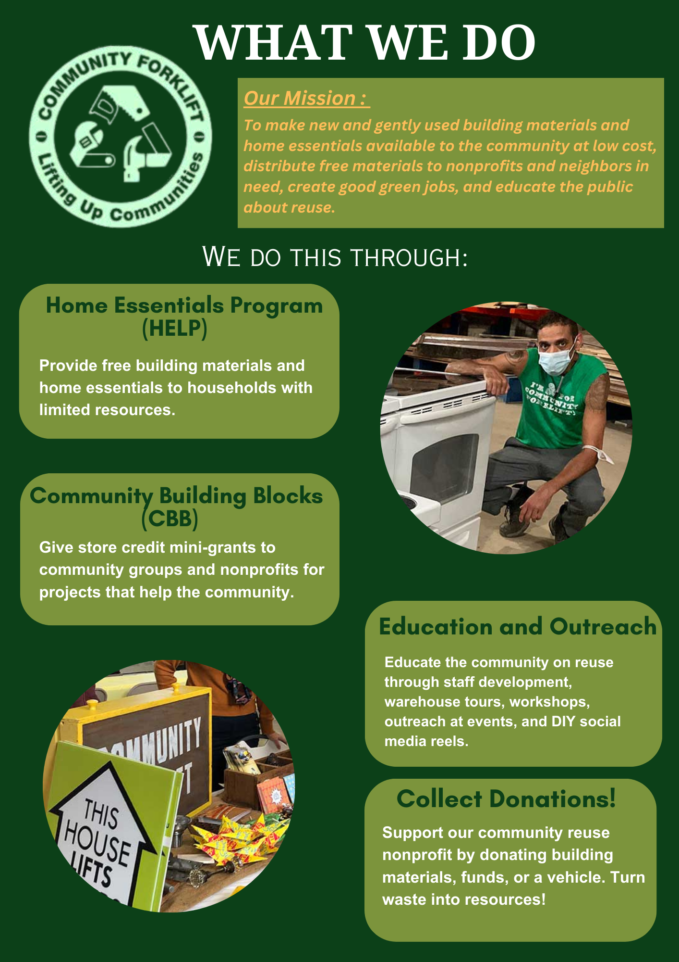
That Proactively Engages and Partners with Others
Front:
Targeted flyer
Catering to wide range of audience
QR code brings to Linked Tree where social media handles are located
Back:
More in-depth of what CF is
Programs and services offered
Can be distributed or hung up on walls, polls, boards, etc.

Slide 11
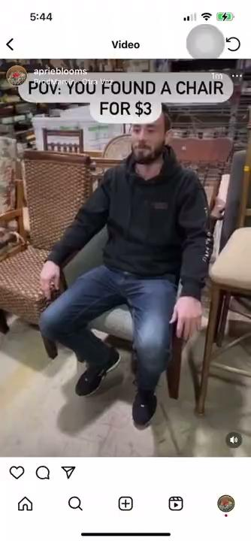
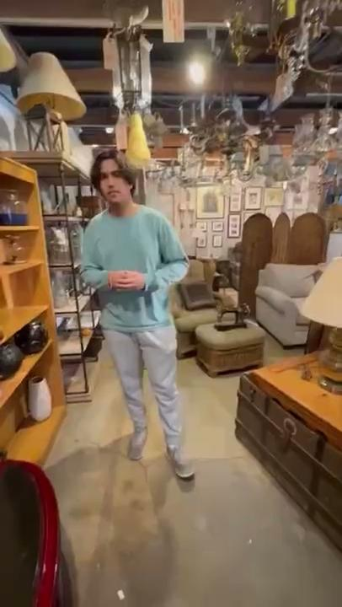
That Proactively Engages and Partners with Others
Short, promotional (< 30 sec) reels, longer informational videos, or a mix

Slide 12
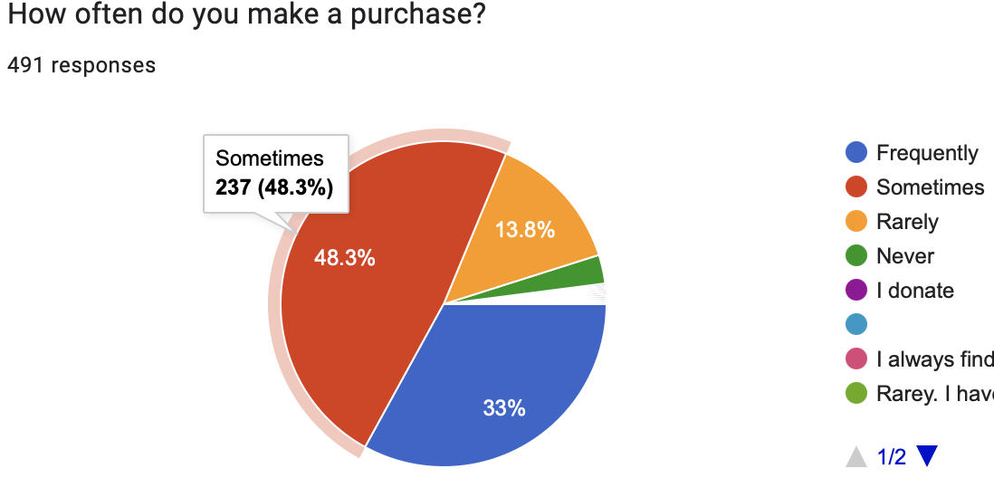
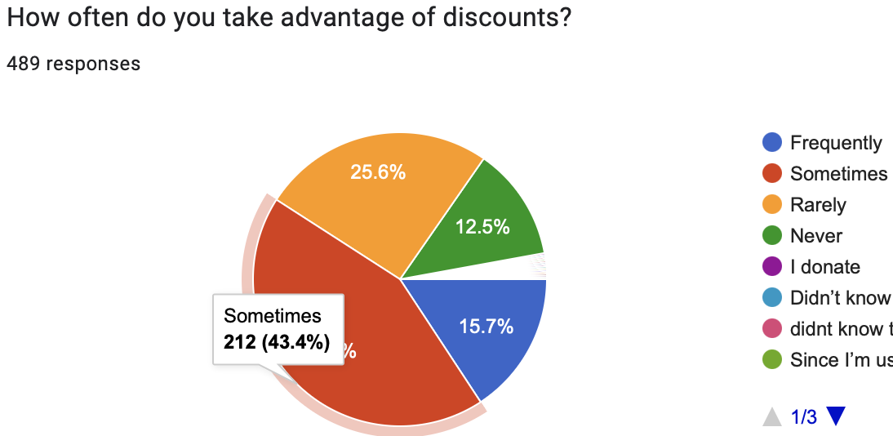
That Prices Well
+Converting “Sometimes” to “Frequently” through pricing techniques

Slide 13
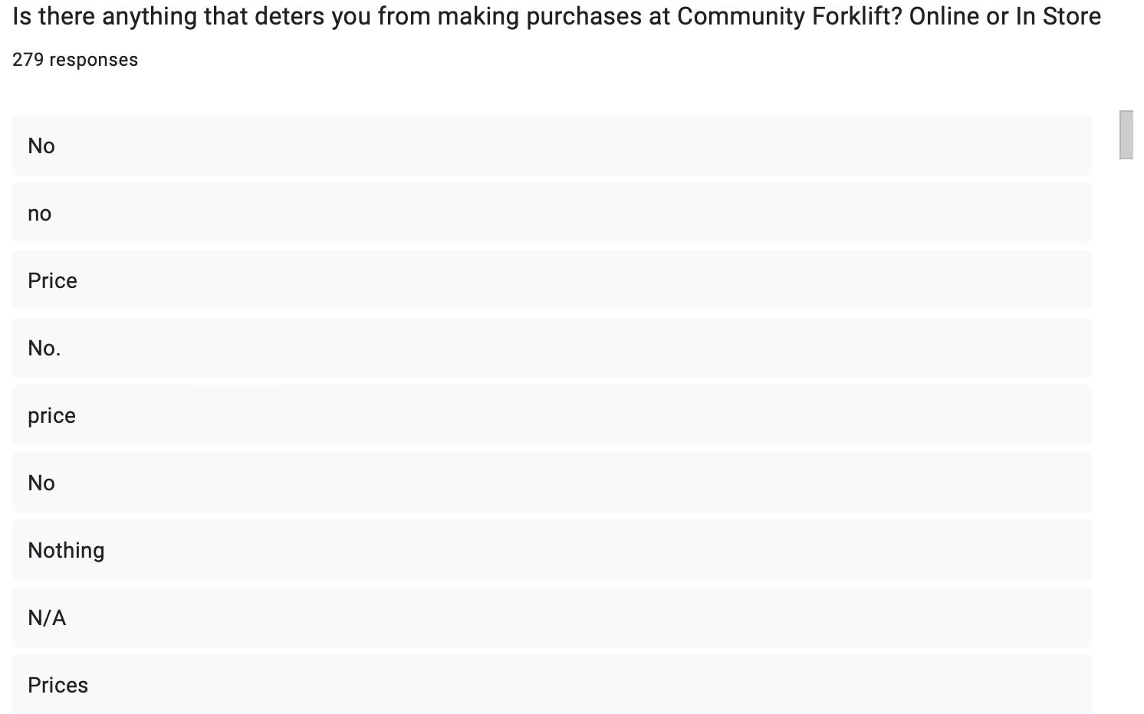
That Prices Well
+Drop Prices / Price Match / Allow Haggling / Have Auctions
-This gets people excited to find a deal
-Still make a profit

Slide 14
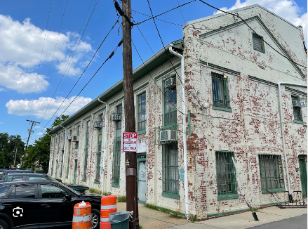
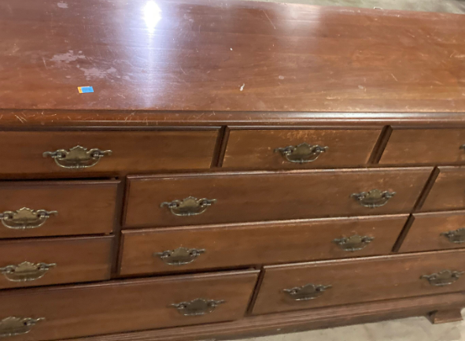
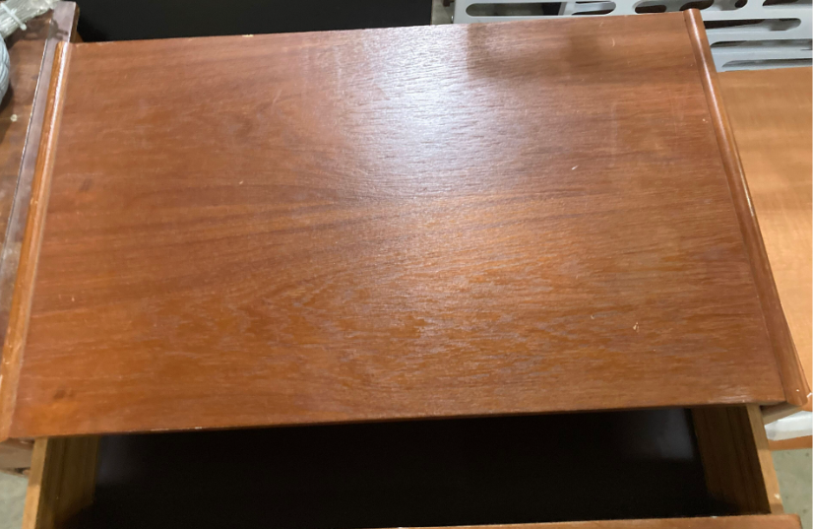
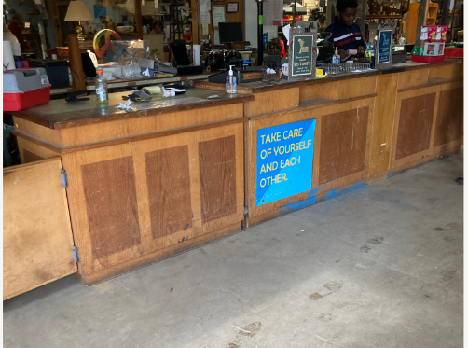
That Prices Well
Make prices and discounts more visible!

Slide 15
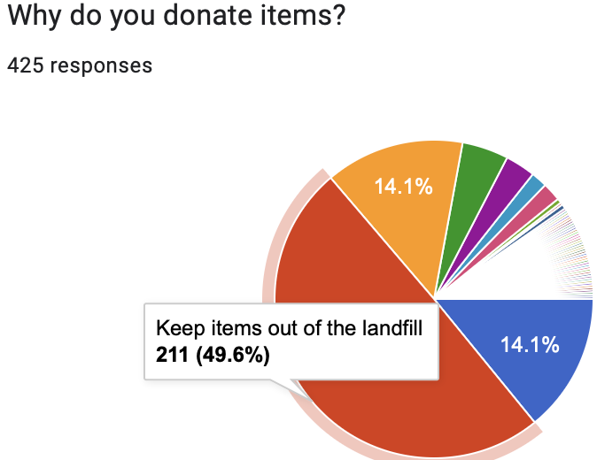
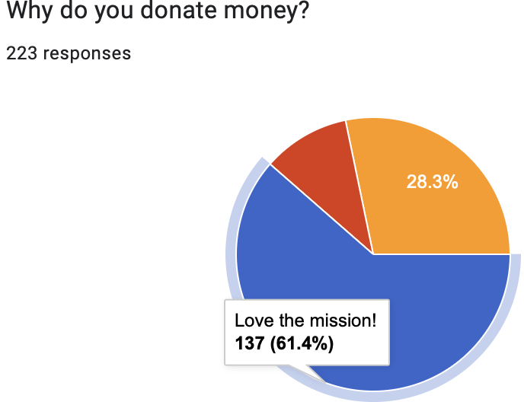
Will Lead the Charge that Enables the DMV to Become the Hero of Reuse and Waste Management.
People want to be the hero and you can lead the charge:
“Just doin’ my thing keepin’ items out of the landfill”
“Not all heroes wear capes, and neither do we…but we keep items out of the landfill so who's talkin’ now!”
“Question: Have you thought about our earth today? Come to Community Forklift where we’re saving our beautiful green planet.”
Community Forklift is a great non-profit
that is truly a force for good
- let’s get
more people to see that!

Slide 16
Sales Analytics
September 2023 had seen most amount of Discounts (13,398)
September 2023 had most amount of sales for in-store point of sale.
Areas of Improvement:
Categories like Steel, Radiators, Toilets, Glass, Tubs and Showers have less contribution towards Sales
Keeping track of discounts over months in any Financial Year
Online Sales and Shopify Sales are significantly low as compared to In-store sales
Check this!
Community Forklifts Sales Data Viz | Tableau Public

Slide 17
Youtube Analytics
Tour videos attract more subscription. This can be very helpful to gain traction and building an audience.
Use redirects from Instagram, Facebook and website to get more traffic on Youtube via reels, short videos.
Create Youtube Shorts (Publish DIY Videos) as they have more attention span for younger viewers
Check this!
Community Forklifts Youtube Viz | Tableau Public

Slide 18
Survey Analysis
Discount Influence - 66% Yes and 28% No
What customers want?
Location - Closer to majority of customers
Better Information Outreach
Pricing
Create locations around DMV for monthly pickups
Better parking around store
More advertising
Longer weekend hours
Delivery Service
Most Survey Responses from DMV region
Check this!
CF Survey Viz Other | Tableau Public
CF Survey Viz Demographics | Tableau Public

Slide 19
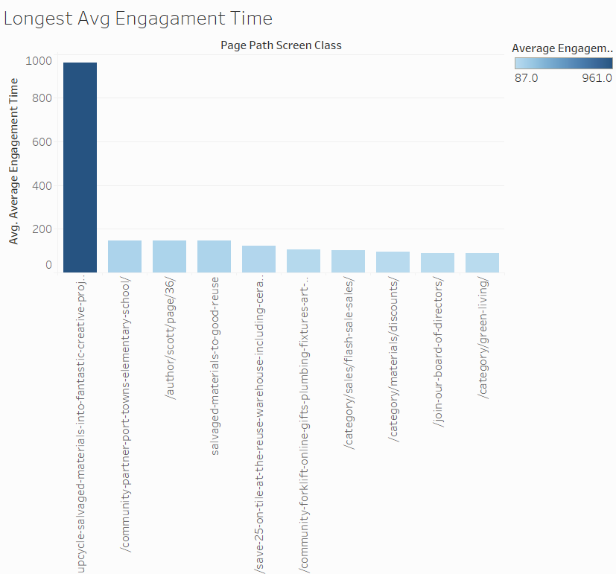
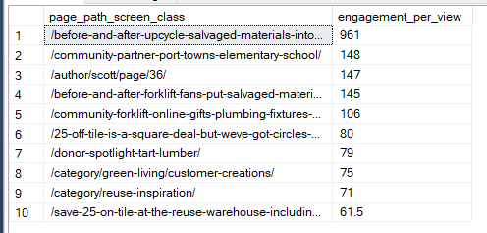
Webpage Data Analysis

Slide 20
Webpage Data Analysis
Longest avg engagement & engagement per view >> What the viewers are most interested in!!
DIY Projects – Upcycle salvaged materials into creative projects
Salvaged materials into good reuse
Green Livings >> Key steps to a sustainable lifestyle

Slide 21
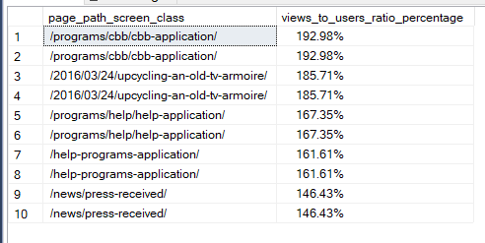
Webpage Data Analysis
Donation Funds >> Most High Performing Page
Great Views to users ratio can be used to optimize opportunities.
Specifically tackle users to revenue ratio.

Slide 22
Insights & Recommendations
Let’s perfect what we are good at >> Donation of Funds
Let’s think out of the box!! >> Working on Social Media Presence >> Instagram and TIK TOK!!
Connecting with other DIY Content Creators.
Connecting with Content Creators who feature sustainability and zero waste living.
Making their social media presence known with Instagram Giveaways etc.
Opening up to newer age demographics.

Slide 23
Staffing
We suggest the following additional staffing to implement these changes
Sales/Marketing Specialist:
To support with partner connections, help with online sales, and ad/social media presence.
Influencer:
To work with team making DIYs, reels, and socials posts.
Additional Crew:
Given a shorter window of donations, a concentrated crew team to proactively organize the warehouse items will be very helpful.

Slide 24
Final Deliverable Summary
Circulate Flyers in 15 Mile Radius
Decrease Donations Hours
Organize Warehouse w/ Extra Hours
Lower Pricing/Price Match/Auction/Haggle
Promote Promote Promote!
Hire Additional Staff to Support
Give Back Even More to The Community

Slide 25
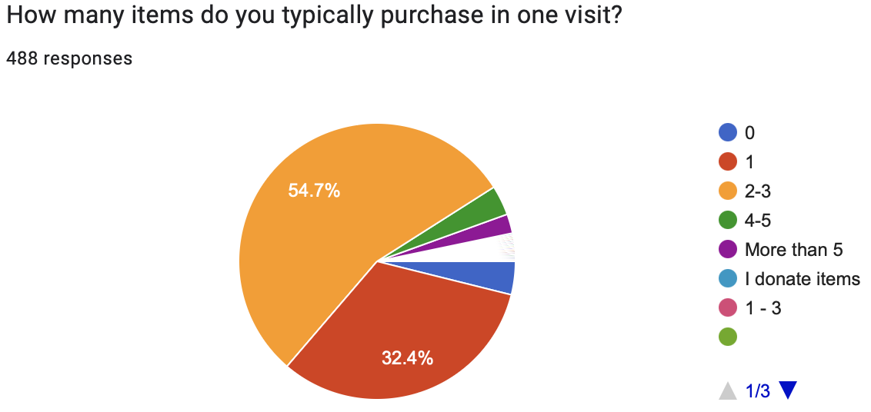
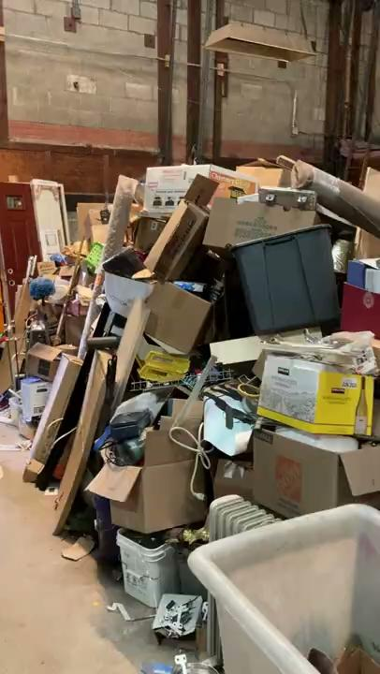
Other Suggestions
GIVING(GIVE GIVE GIVE!) (More in Paper to Come)
-Convert the red space into orange by offering free items with purchases
-Nails (for hammer), a fun stocking, or any $1 item
-Everything is donated so we think if Community Forklift shows such
generosity here, their mission will spread and bring people in
-Buy $25, $50, $100, $250, $500 and get certain other items for free
-Partner up with a delivery company to take things back to houses
-On a contractual basis
-Get a grant for this?
-Make delivery services more visible
-Partner with shelters, soup kitchens, and more to give items that don’t sell
-Senior discount
-Landing Page should show categories off the bat with mission information at bottom
-Training for Crew Members for worker retention
-Flash sale for new students in DMV area on annual basis

Slide 26
Impact Consulting Fellowship
CENTER FOR SOCIAL VALUE CREATION
Thank you - Q&A?
December 15th, 2023

