Slide 1
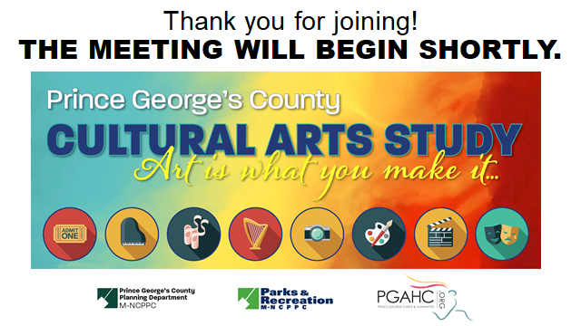

Slide 2




Learning about the NEW Zoning Ordinance and Subdivision Regulations Update is as easy as ...
1
Find Your New Zone
Visit http://zoningpgc.pgplanning.com
to find your proposed new zone
2
Practice Using the New Code Take the online Zoning Training Course at http://zoningpgc.pgplanning.com/training
3
Contact the Project Team
Meet one-on-one or host a community training:
  301-952-4544
  zoningpgc@ppd.mncppc.org

Slide 3
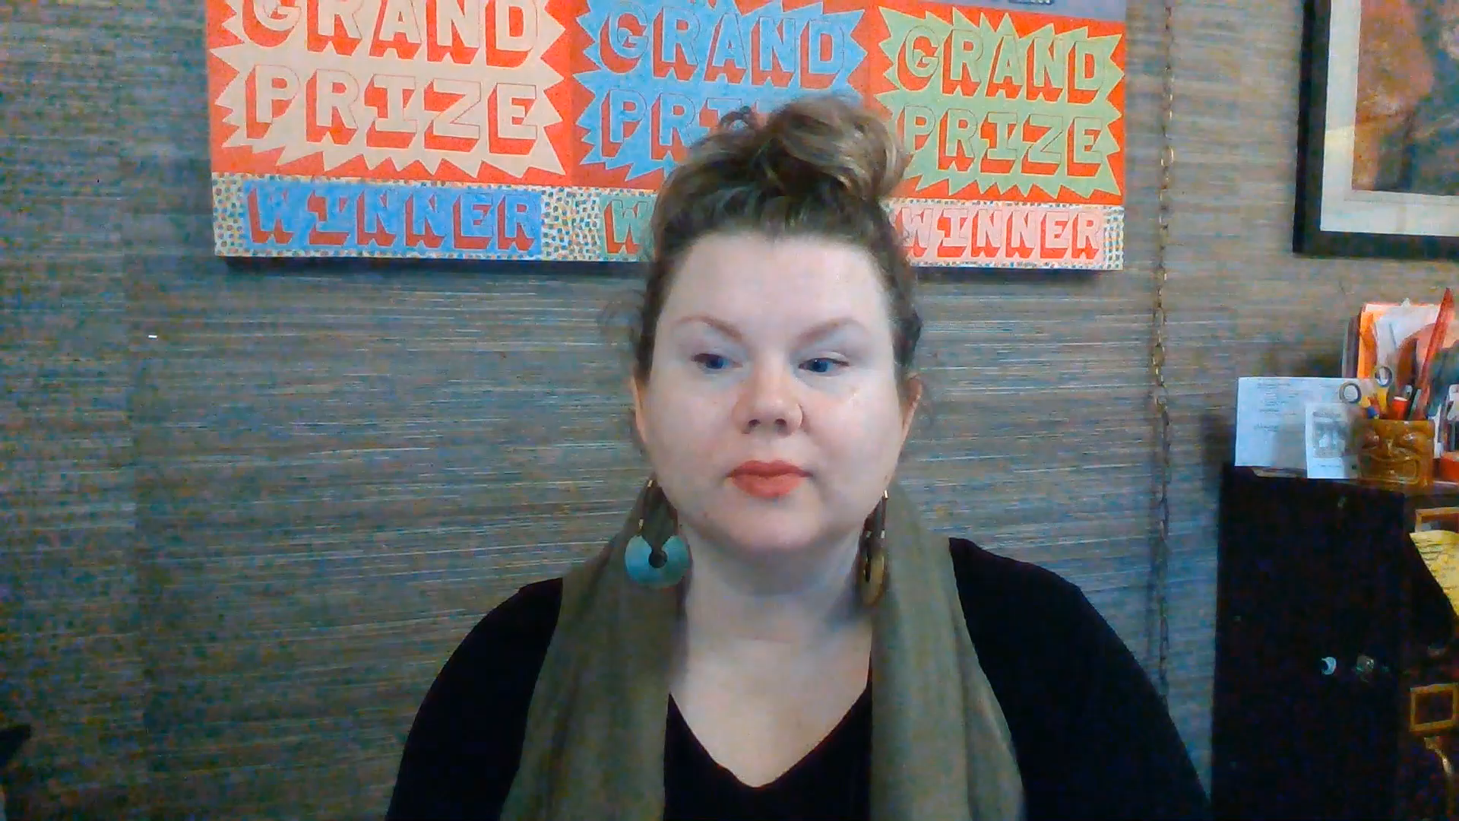

Slide 4
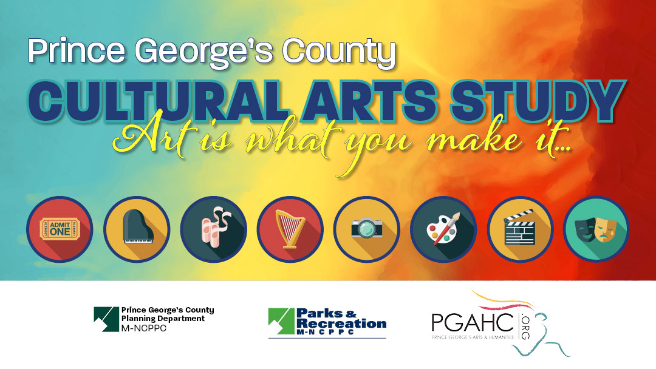
Role of Arts
in Creative Placemaking
February 18, 2021

Slide 5
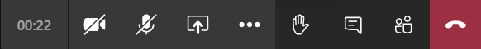
HOW TO PARTICIPATE - TEAMS
  This meeting will be recorded and shared on the website
  Please MUTE yourself and turn OFF your video, until called upon
  If you have a comment or question, type it in the chat
  Unmute yourself if called upon.
TURN ON/TURN OFF CAMERA
MUTE/UNMUTE
OPEN MEETING CHAT

Slide 6
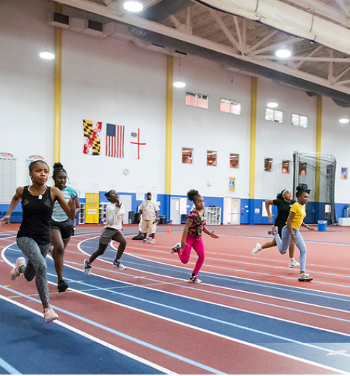

AGENDA
Welcome and Introductions
Project Overview
What’s Happening in
Prince George’s County
Case Studies
Breakout Group Discussion
Image Source: Maryland-National Capital Park & Planning Commission. Safe Summer Track and Field Showdown. Photo by Khalil Gill.

Slide 7
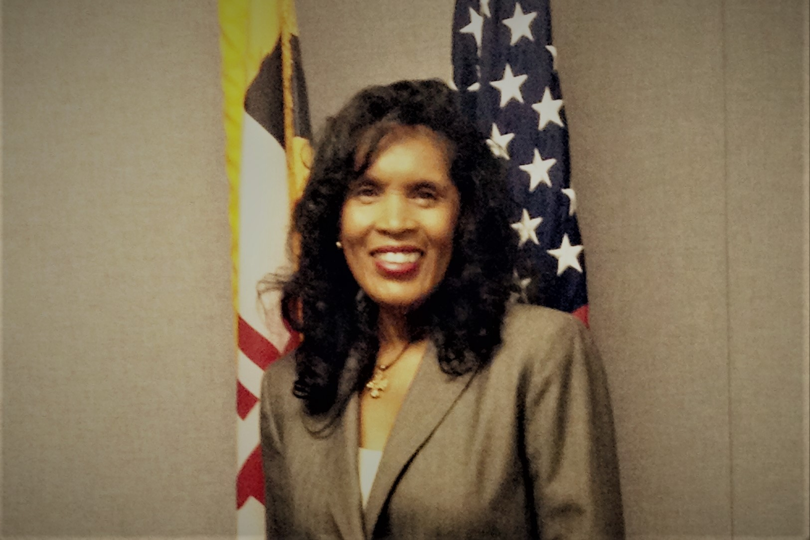
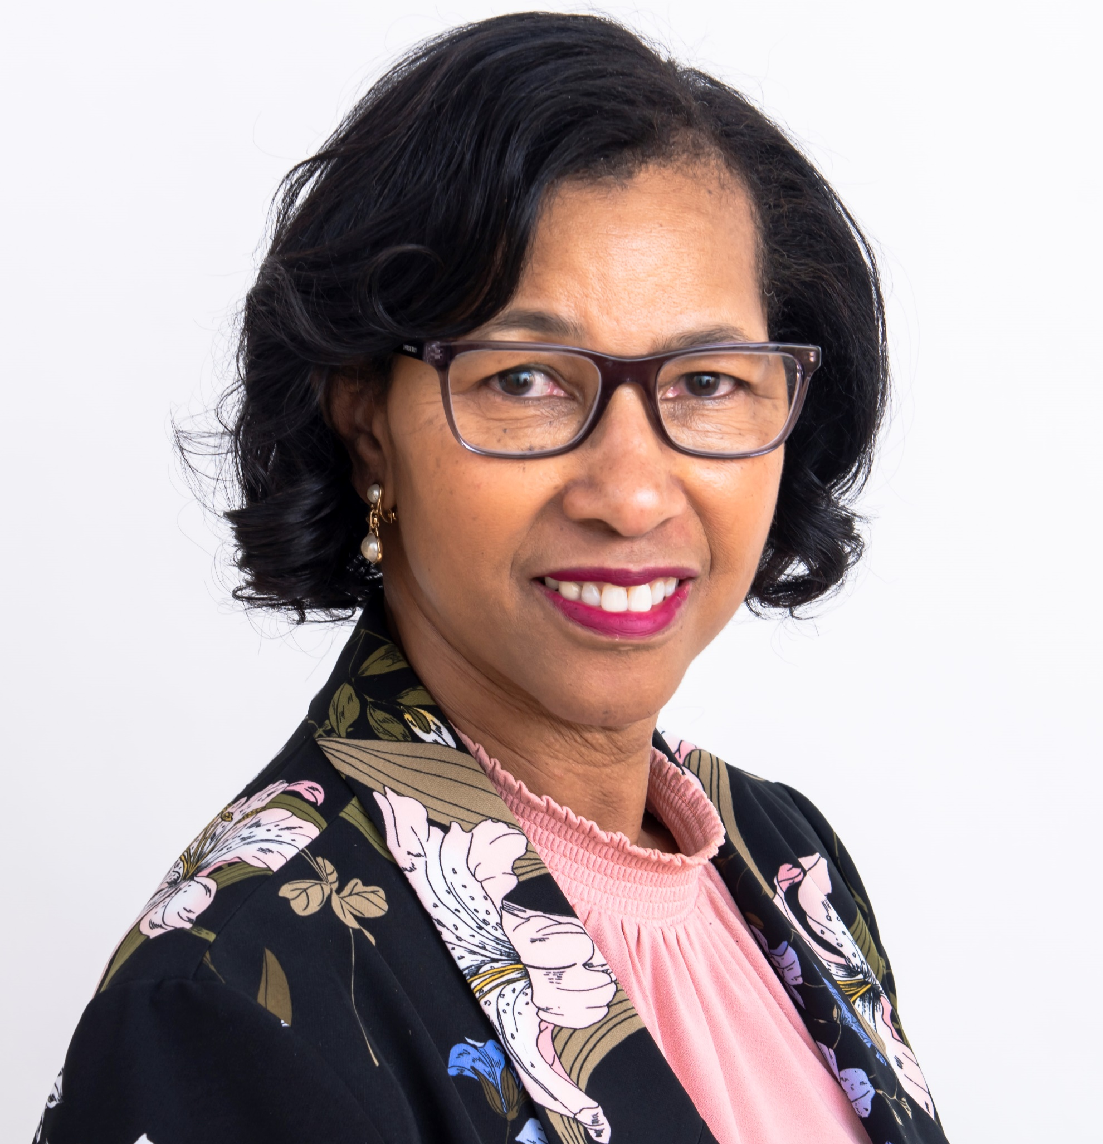
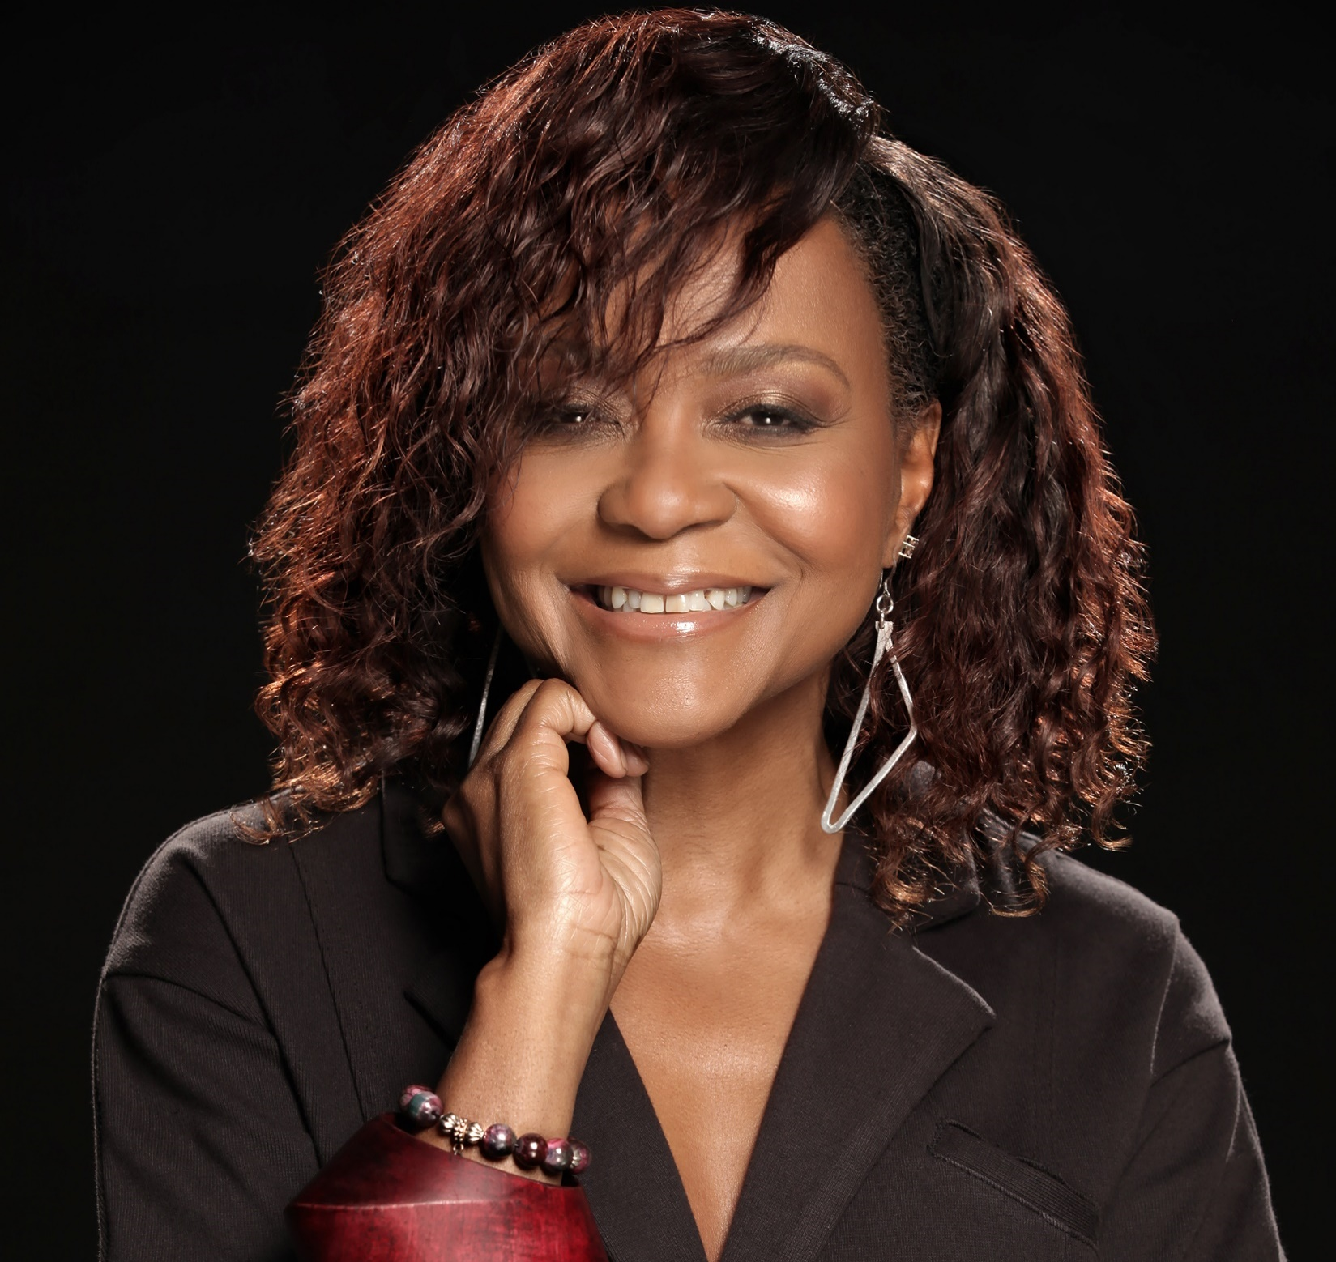
VANESSA AKINS,
Special Program Coordinator
Prince George’s County Planning Department
MEET THE TEAM
DARLENE WATKINS,
Division Chief, Arts and Cultural Heritage Division
Prince George’s County Department of Parks and Recreation
Prince George’s Cultural Arts Study
RHONDA DALLAS,
Executive Director, Chief Curator
Prince George’s Arts and Humanities

Slide 8
YOUR PLANNING TEAM
JOY BAILEY BRYANT
President, U.S.
Lord Cultural Resources
Project Lead
EVE MOROS ORTEGA, M.P.A
Senior Consultant
Lord Cultural Resources
Project Manager
TIFFANY LYONS
Research Consultant
Lord Cultural Resources
Research and Project Support
JON STOVER
Managing Partner
JS&A
Economic Development Strategy Lead
STAN WALL, P.E.
Partner
HR&A Advisors
Project Advisor, Economic Development Strategy

Slide 9
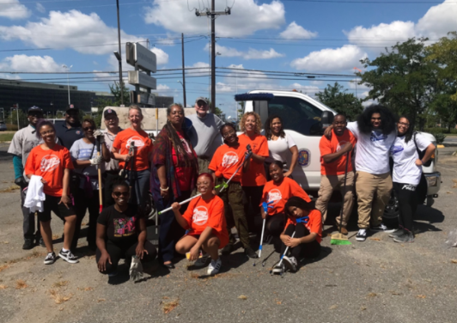
WHAT is the Cultural Arts Study?
A comprehensive assessment of the diverse arts and culture ecology in Prince George’s County
WHO is creating it?
Prince George’s County Planning Department, Department of Parks and Recreation (DPR), and the Prince George’s Arts and Humanities Council
Steering committee, arts advisors, and key stakeholders—broad spectrum of County voices
Everyone is invited— please spread the word!
Image Source: Joe's Movement Emporium blog article on Creative Suitland

Slide 10
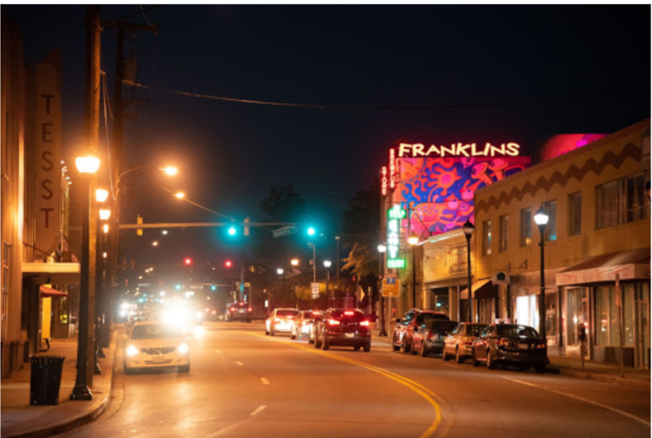
Explore
Explore how the arts, culture, and entertainment can play a role in shaping the lives of Prince George’s County residents and their communities
Identify
Identify needed policy changes to ensure the cultural arts are included across all sectors
Ensure
Ensure that arts and culture are included throughout the County’s infrastructure to advance cultural goals and creative placemaking
Increase
Increase opportunities for public art, community art projects, and infrastructure support for artists
Leverage
Leverage arts and culture as a game-changing urban revitalization strategy that will assist in improving the quality of life in our communities across the County
WHY?
Photo Source: M-NCPPC. Prince George’s County Planning Department. 2018.
Notes:
The purpose of this study is the overall integration of arts into the economic framework

Slide 11
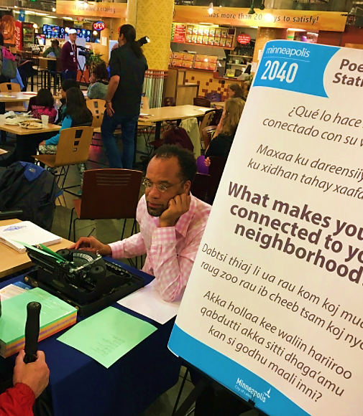
BUILDING
WITH CULTURE
Arts & Culture can address many community needs including:
Housing & Neighborhood Development
Education
Quality of Life
Talent Development/Retention
Economic Vitality
Tourism & Live/Work
Image Source: Americans for the Arts
Notes:
Joy
Today we are talking about the ways that arts and culture can literally make our places better.
Placemaking capitalizes or uses local arts and cultural assets—and we call arts and culture assets because that is exactly what they are places and opportunities that make our communities better.
Through placemaking, arts and culture impacts all of the elements you see listed here--
Placemaking draws from inspiration, and potential, with the intention of creating public spaces that promote people's health, happiness, and well-being.
Placemaking is a multi-faceted approach to the planning, design and management of public spaces.

Slide 12
HOW AND WHEN?
NOW
Economic Development
Report
Background Review
Stakeholder Interviews
6 Community Meetings
Cultural Participation Survey
Community Meeting
Final Cultural Arts Study
Presentation of Key Findings
Draft Cultural Arts Study
Summer 2020 – Fall 2021
Notes:
Eve

Slide 13
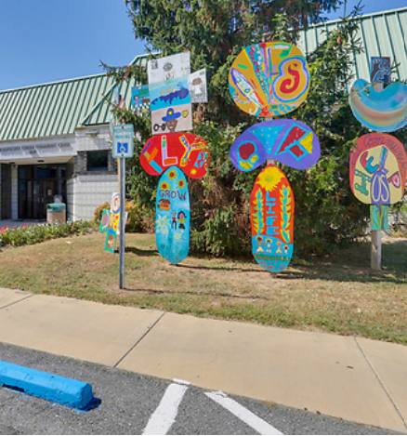
PLACEMAKING
Leverage arts and culture to improve quality of life, increase creative activity, and create distinct sense of place.
Arts and culture improve physical and social character of an area and promote enduring social change.
Transform communities into lively, beautiful, and resilient places with the arts at their core.
Crucial involvement of a wide variety of community stakeholders
  Image Source: M-NCPPC, Department of Parks and Recreation, Prince George's County. Northern Area Division.
  Rollingcrest / Chillum Community Center. Photographed by Claude Langley. 2019.
Notes:
Eve
This can be as simple as transforming an overgrown park to a space for garden clubs, live music, or lending libraries, or as ambitious as programs to reduce crime and increase educational attainment through art-based strategies.
For the Prince Geoge’s County Cultural Arts Study, we want to understand how to use principles of creative placemaking to help communities thrive.
A central concept in placemaking is integrating arts and culture with other needs of a community, including land use, transportation, education, housing, infrastructure, and public safety strategies.
I'll turn the microphone over to Rhonda Dallas of the in

Slide 14
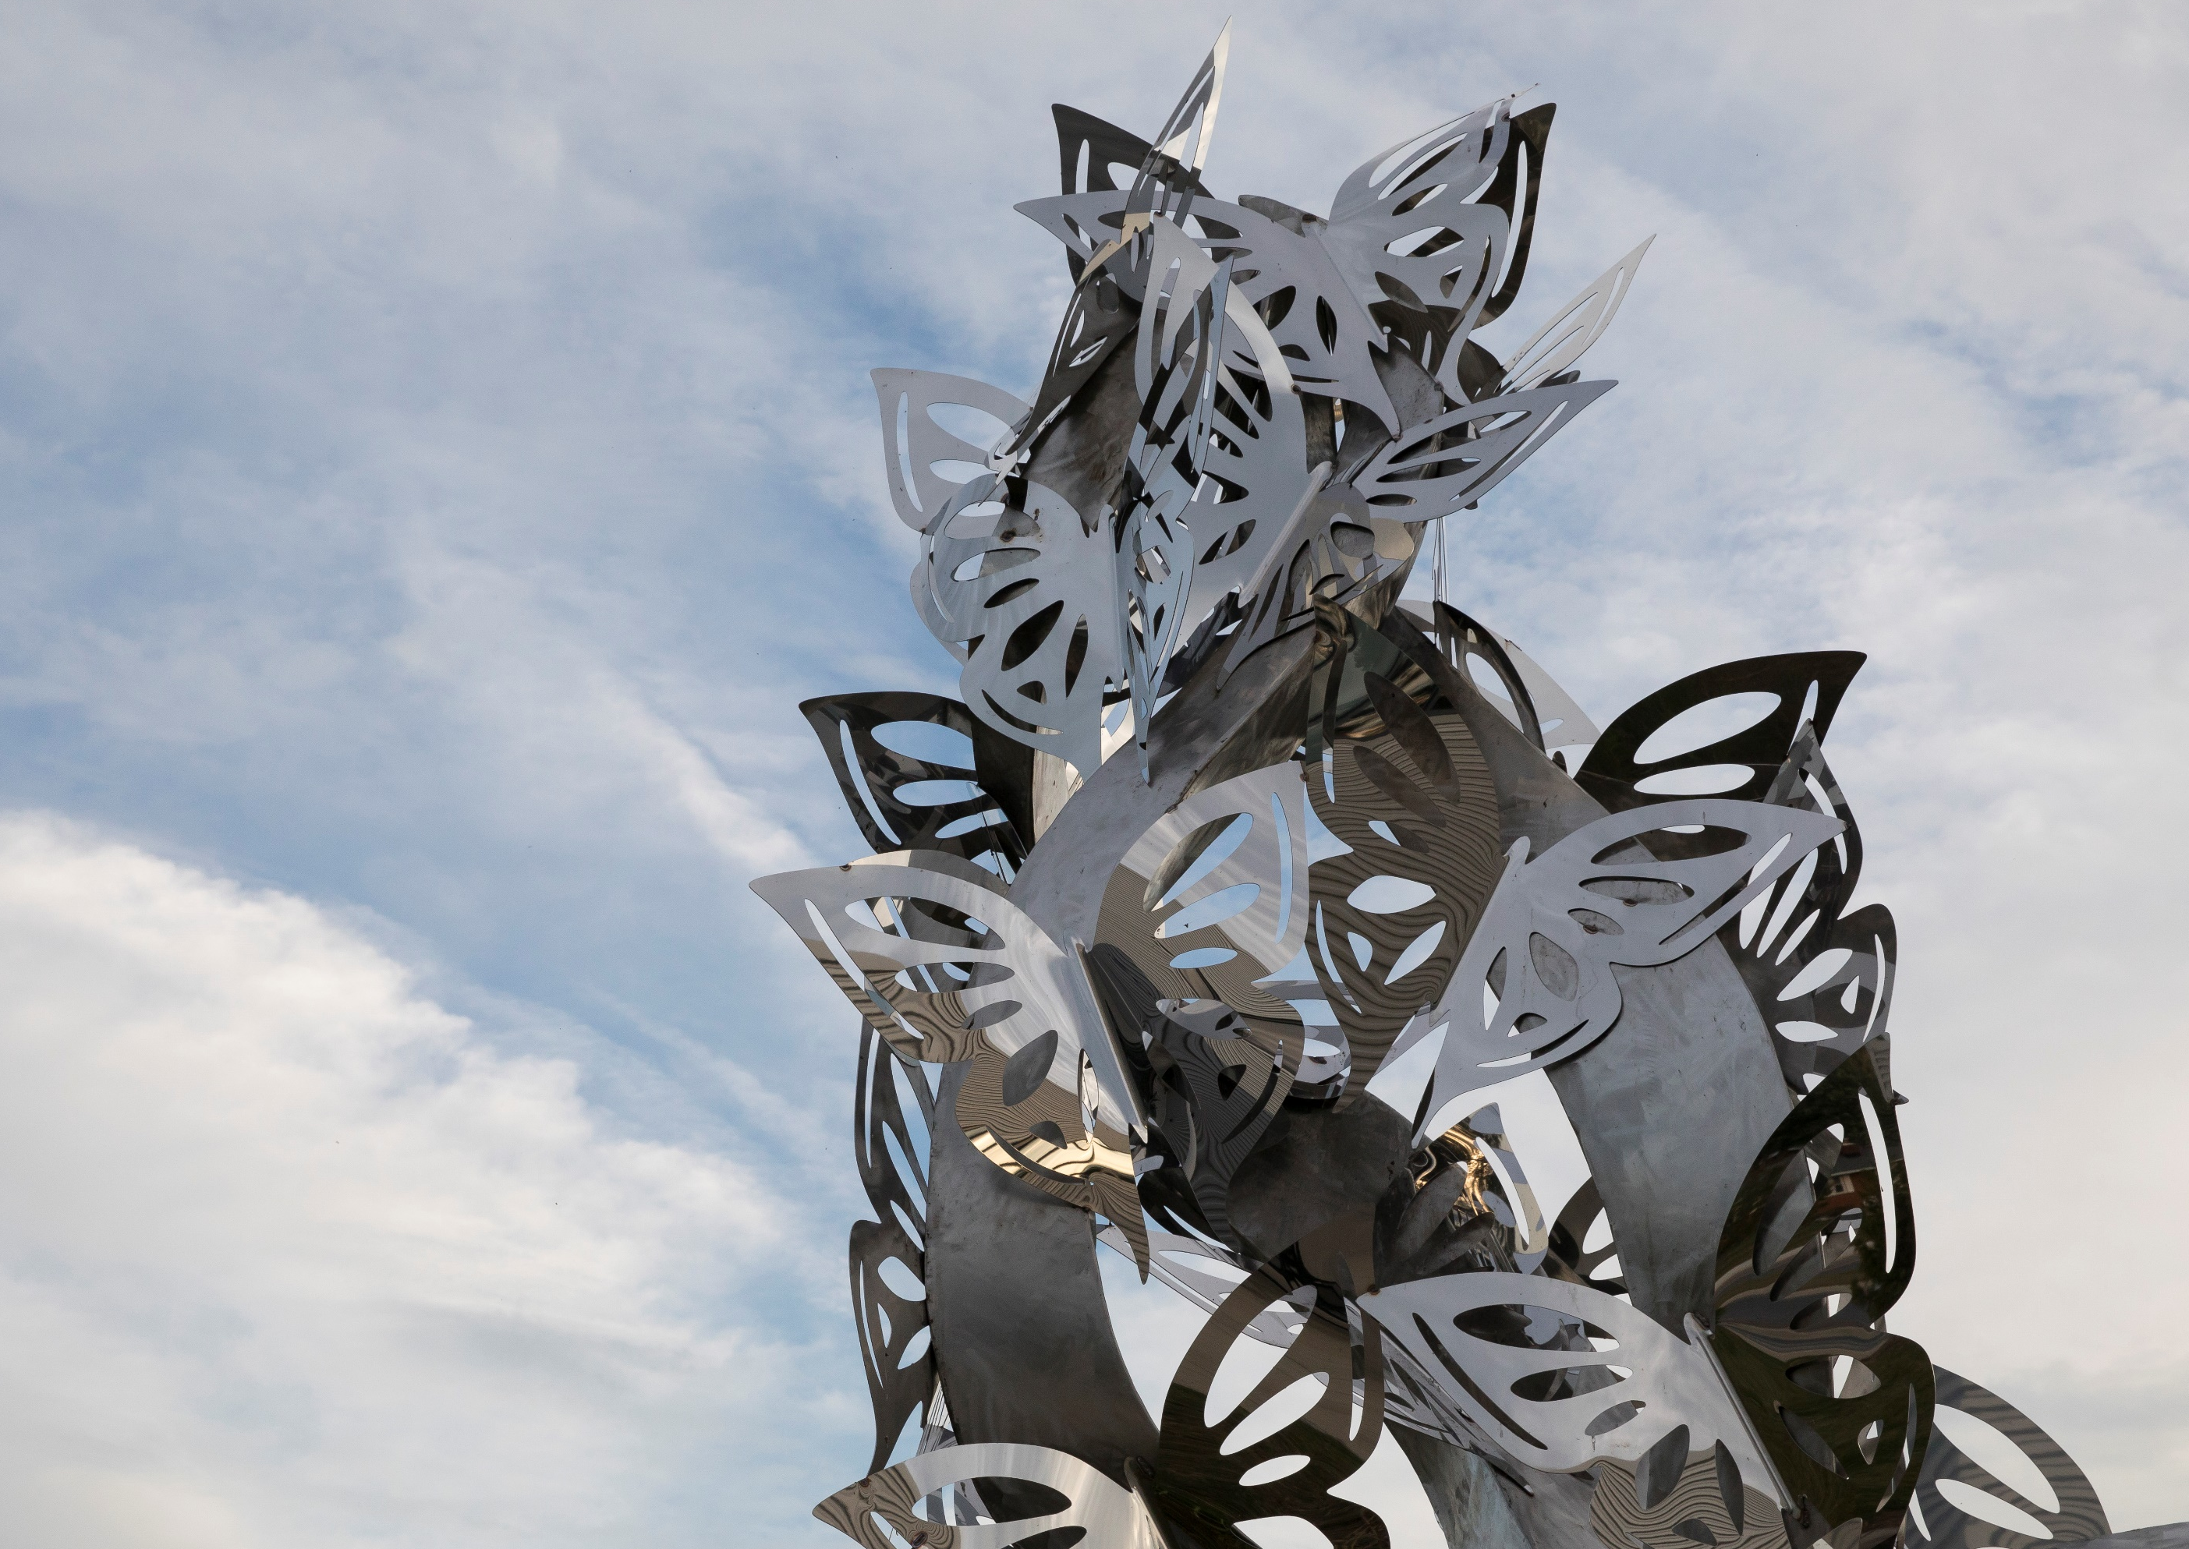
PLACEMAKING WITH ART
IN PRINCE GEORGE’S COUNTY
Notes:
Rhonda

Slide 15
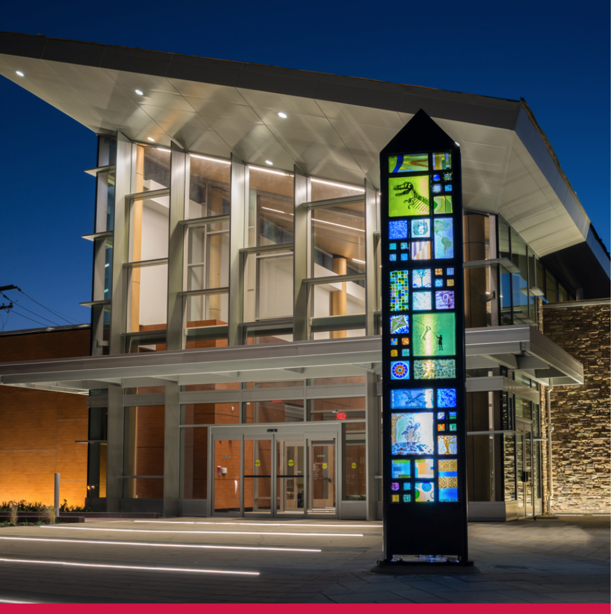
Prince George’s County ART IN
PUBLIC PLACES
For nearly 25 years, the Art in
Public Places program focuses on incorporating public art into County construction projects.
  Laurel Branch Library Installation
  Local artist studio
  Washington Glass School
  Mount Rainier
  Image Source: PGCMLS

Slide 16
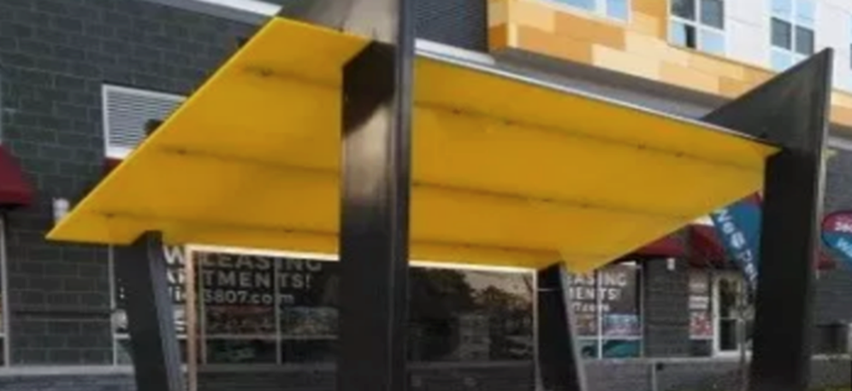
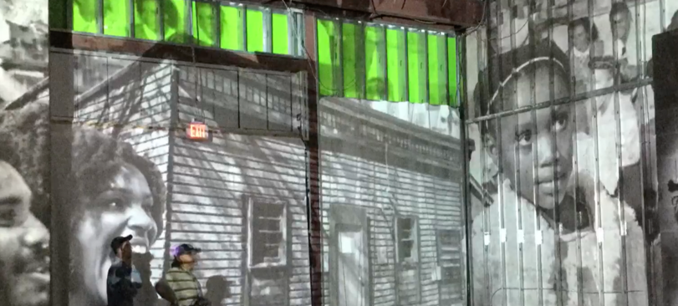
PUBLIC ART
Municipal Bus Shelter Pilot Project
Prototype beautification project in front of Studio 3807 and miXt Food Hall in Gateway Arts District
Arts'tination Installation at the 2019 Gateway Open Studio Tour
Tagtool App projects digital designs onto building and audience members can contribute to it live.
Notes:
Pilot Prototype for Municipal Bus Shelter Project - a Partnership between PGAHC, Hyattsville CDC & LAND ex Development
This prototype bus shelter beautification project stands in front of Studio 3807 and SAVVOR food hall in the heart of the Gateway Arts District.
PGAHC ‘Tagtool’ Public Art Installation at the 2019 Gateway Open Studio Tour
This is an example of impactful temporary installations that PGAHC can orchestrate for events and special projects. We teamed with the Austrian based business OMAI and they used their ‘Tagtool’ app to design projections that audience members were able to contribute to.

Slide 17
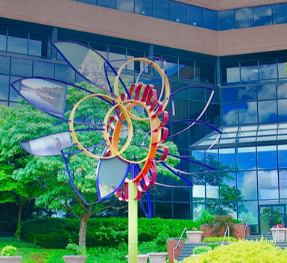
PUBLIC ART
Environmental Public Art Sculpture
PGHAC Administrative Offices at 1801 McCormick Drive in Largo
- ArtWorks Now
- Department of Environment

Slide 18
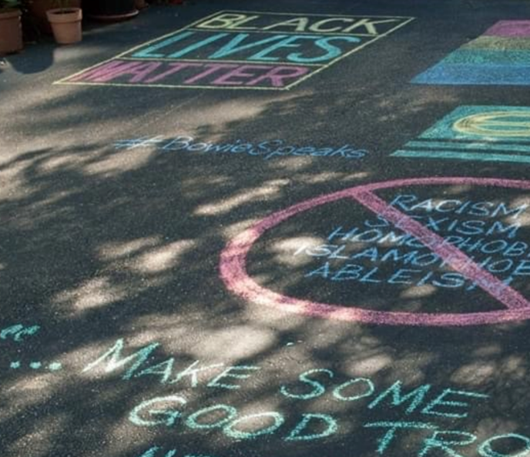
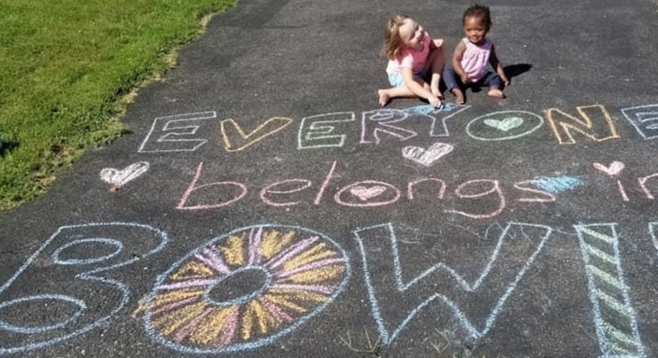
PUBLIC ART
City of Bowie
Community Chalk Art and Social Justice Project

Slide 19
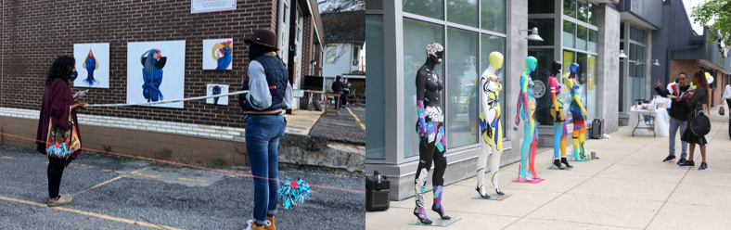
Inside Out Studio at
Red Dirt Studios
Live painting event; safe, innovative way to bring art
to a public audience.
Mannequin Project at 2019 Open Studio Tour
Temporary art activation around the perimeter of the building
Notes:
Gateway Arts District – Inside Out Studio at Red Dirt Studios & Mannequin Project at 2019 Open Studio Tour
Live painting event outside Gateway Media Arts Lab and DPARK3311 in Mt. Rainier
Red Dirt Studios produced a safe and innovative way to bring their artists’ work to a public audience.
Visitors had the opportunity view socially distanced art strategically placed around the perimeter of the building.

Slide 20
CASE STUDIES: PLACEMAKING
Kentucky Center for African American Heritage: Louisville, KY
Greensboro Over Under Pass: Greensboro, NC
Creative Entrepreneurship Project: San Jose, CA
Phoenix Public Art Program: Phoenix, AZ
Meet Me at the Triangles: Montgomery County
Dance Place 8th Street Arts Park: District of Columbia

Slide 21
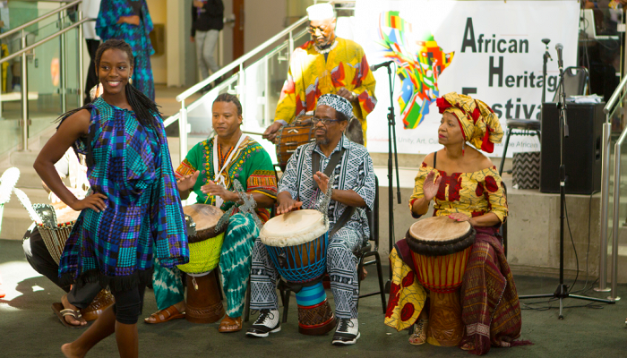
Kentucky Center for African American Heritage
Louisville, Kentucky
Public workshops blending traditional West African and Appalachian arts with contemporary urban performance
Funded by government grants and revenue from facility rentals
Programs and workshops are available to children and adults and class trips.
The long-term plans include recording studios, trade workshops, and a theatre
Image Source: Kentucky Center for African-American Heritage
Notes:
In Louisville, KY, the Mayor’s Office of Safe and Healthy Neighborhoods is investing in projects to reduce violence and increase educational attainment among young African Americans.
These workshops will decrease youth violence as a result of this increase in youth participation in community development efforts alongside municipal investments and strategies.
Targeted areas of the city classifed as zones of hope – with issues of poverty, violence, decided to apply art placemaking to help community development
Artists and community members went to Appalachia and made linkages there, and looked at the social-economic issues that relate outside of their communities, wanted to link the notion of the banjo, a lot of people don't realize it came from Senegal, about the artist development as well, brought them to address the issues of the community, bringing together a production performed to 4 sold out shows, many of them have gone on become a major poet in the area, got great recognition in the area, helped the community come to grips with issues that the performance was dealing with. Challenge is sustaining it.
$500K annually, about half is public funding (city/state), and other half is earned income from events, rentals
The Kentucky Center for African American Heritage will support a collective of Louisville-based artists to lead immersive public workshops blending traditional West African and Appalachian arts with contemporary urban performance technaiques. The Heritage Center is funded by government grants and earned revenue from facility rentals for events.
The Heritage Center’s education programs and workshops are available to children and adults. The Heritage Center also regularly host class trips from local schools. The long-term plans include:
Recording studios where students can learn the craft of the music industry
Trade workshops where they can learn carpentry and construction
Black box theatre where students can learn not only how to act on stage, but also skills they can use to handle the backstage aspects of both live theatre and film.

Slide 22
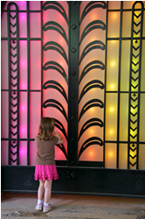
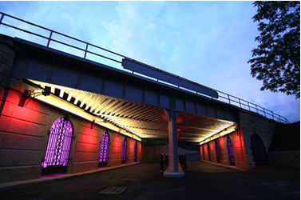
Photo Source: Downtown Greenway, Greensboro, NC.
(Right Photo Photographed by Peter Vahan)
Railroad overpass formed a barrier between city center and underserved neighborhoods
Local nonprofit created four-mile, multiuse greenway encircling downtown.
Used public art along the pedestrian route
to transform urban landscape
OVER.UNDER.PASS
Greensboro, N.C.
Notes:
For decades, the overpass of a railroad line in Greensboro, North Carolina, had formed a barrier between its city center and its historically underserved neighborhoods to the south.
A plan was conceived by Action Greensboro, a local non-profit focused on economic, educational, and cultural development in the city, for a four-mile, multi-use greenway that would encircle and define its downtown. Action Greensboro saw an opportunity to use public art along the pedestrian route to transform its urban landscape and re-establish connections within the community.

Slide 23

Creative Entrepreneurship Project (CEP)
San Jose, California
Enrich cultural vibrancy and enhance creative economy by actively providing support to artists living or working in San Jose.
City-led Creative Entrepreneur Project (CEP) focuses support on individual artists, rather than typical support for organizations.
Began with a needs and resource assessment
Pilot training programs, pilot program of encouragement grants, and convening opportunities.
Notes:
It was inspired by the City's commitment to support local arts community and was prompted by the absence of specific focus on individual artists in the long-standing efforts of the City to support the community.
The Creative Entrepreneur Project (CEP) is led by the Office of Cultural Affairs (OCA), to improve the San Jose opportunity landscape for independent artists, regardless of their medium or field of practice.
The primary goal of this program is to enrich San Jose’s cultural vibrancy and enhance its creative economy by actively providing support to artists (across all disciplines in both the non-commercial and commercial arenas) living or working in San Jose.
Launched in 2008, the initiative paired the resources and goals of the OCA with the expertise and resources of the Center for Cultural Innovation (CCI) to better understand the career ambitions, needs and the challenges artists face as individuals living and working in the Silicon Valley economy.
All the CCI Workshops are made possible in part by grants from Los Angeles Arts and Culture, City of Los Angeles Department of Cultural Affairs , California Arts Council.

Slide 24
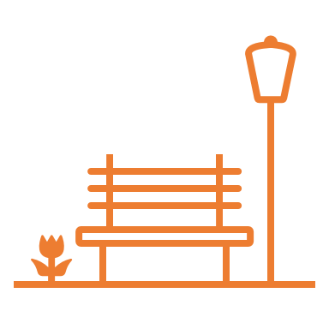
Infrastructure as Public Art
Phoenix, Arizona
Infuse art and design into public facilities and spaces—freeway overpasses, recycling centers, neighborhood parks
Landmark citywide public art master plan and percent for art funding stream.
City has invested over
$30 million in public art in past 20 years
Notes:
Goal of this program since 1986 is to infuse art and design into public facilities and spaces ranging from freeway overpasses to recycling centers and neighborhood parks.
Civic leaders envisioned public art helping to enhance Phoenix’s quality of life, commissioning a landmark citywide public art master plan and percent for art funding stream.
Over 20 years, Phoenix has invested over $30 million in public art, installing public art at highway underpasses, around canals and trails, on pedestrian bridges over freeways, and around recycling centers.” (“Creative Placemaking”, National Endowment of the Arts)
Funded through a 1% annual allocation on City’s Capital Improvement Program to public art
Creating a more livable place for Phoenix residents and providing residents with opportunities to shape local art projects by providing input at public art planning meetings.

Slide 25
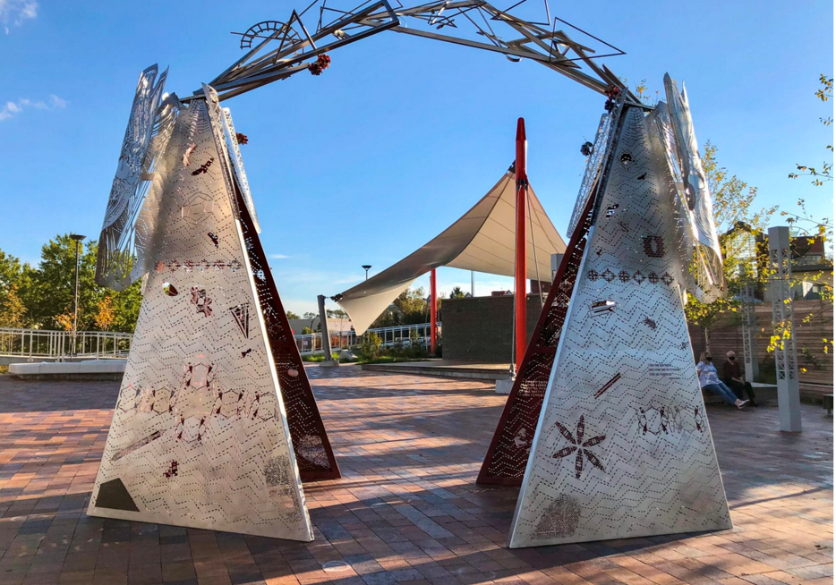
Meet Me at The Triangles
Montgomery County
Public art sculpture
Capstone of major civic placemaking project
Part of larger project, the Wheaton Headquarters, a new County office building
Represents largest public and private investment in Wheaton since construction of Metrorail
Sits at pedestrian crossroads of major transportation, retail, and office investments
Funding and project management partnership between developer and Arts and Humanities Council of Montgomery County
Photo Source: Meet Me At the Triangles, Public Art Installation by master artist, Norie Sato and contributing artists Adrienne Moumin, Eric B. Ricks, and Achamyeleh Debela and poet Maritza Rivera. Image courtesy of the Arts and Humanities Council of Montgomery County.

Slide 26
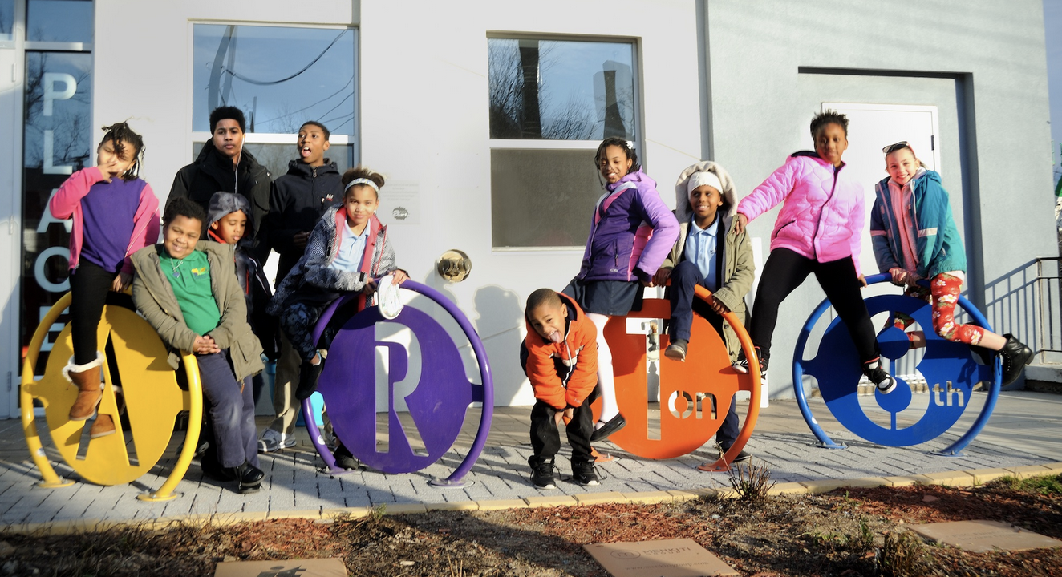
Dance Place 8th Street Arts Park
District of Columbia
Neighborhood cultural center in the Brookland/Edgewood neighborhood, a low-to moderate income community
Dance Place 89th Street Arts Park reclaimed underused spaces adjacent to cultural institutions, bringing cultural activities to a broader community beyond the indoor spaces
Opened in 2016 as final phase of Dance Place’s arts campus
Worked with Kresge foundation, private developers, and community stakeholders to transform the neighborhood with arts-based strategies
Photo Source: Courtesy of Dance Place

Slide 27

BREAKOUT ROOMS

Slide 28
Breakout Rooms are in Session

Slide 29
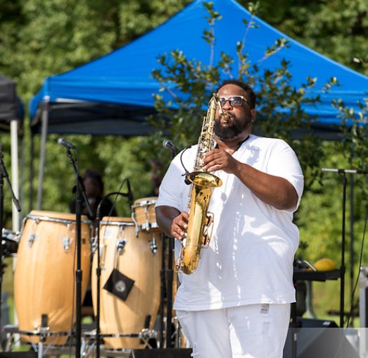




DISCUSSION QUESTIONS
What are existing examples of successful placemaking/
neighborhood revitalization in Prince George’s County, and how can these be a model for other areas?
What are your key goals for neighborhood creative placemaking and neighborhood revitalization through arts and culture?
What do communities need to successfully create placemaking projects?
Where are there
opportunities in the County for creative placemaking?
Image Source: MARYLAND-NATIONAL CAPITAL PARK AND PLANNING COMMISSION. Fairwood Community Park Music Festival / 2019.
Photo By: Khalil Gill

Slide 30
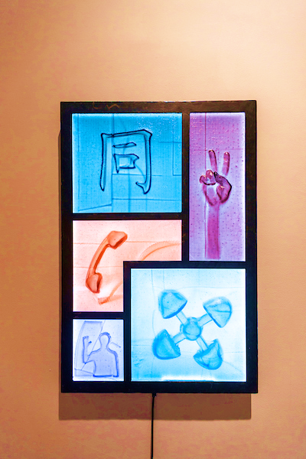
Q&A
Please take yourself off mute or enter
your questions in the
chat box now.
Image source: M-NCPPC, Department of Parks and Recreation, Prince George's County,
Photographer -Claude Langley Jr.

Slide 31
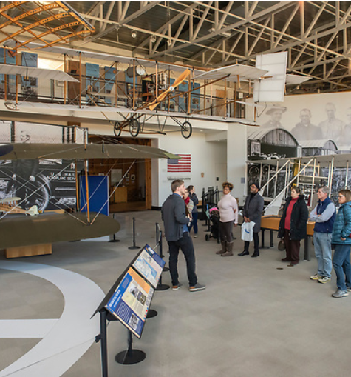
WHAT’S NEXT?
Take and promote the cultural participation survey: https://www.surveymonkey
.com/r/PGCCAStudy
Visit https://bit.ly/PGCCAStudy
Volunteer to host Community Culture Circles with friends and family about experiencing arts and culture in Prince George’s County
Upcoming meeting: Thursday, April 8, at 7:00 p.m. on Arts and Connectivity
Image Source: M-NCPPC, Department of Parks and Recreation, Prince George's County. AFRICAN AMERICAN AVIATORS TOUR. Photo By: Khalil Gill

Slide 32
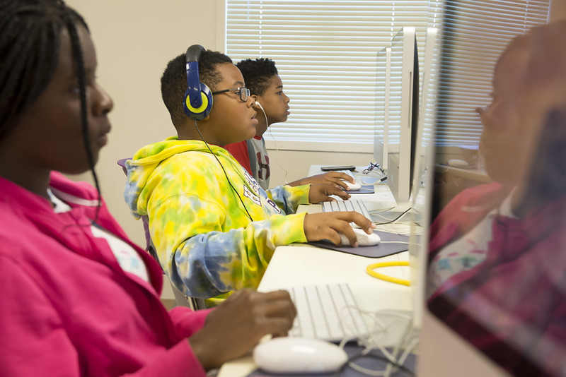

CONTACT US
PGCCAS@ppd.mncppc.org

Slide 33
THANK YOU FOR YOUR PARTICIPATION!
STAY INVOLVED!
http://www.mncppc.org/4860/Cultural-Arts-Study

