Slide 1
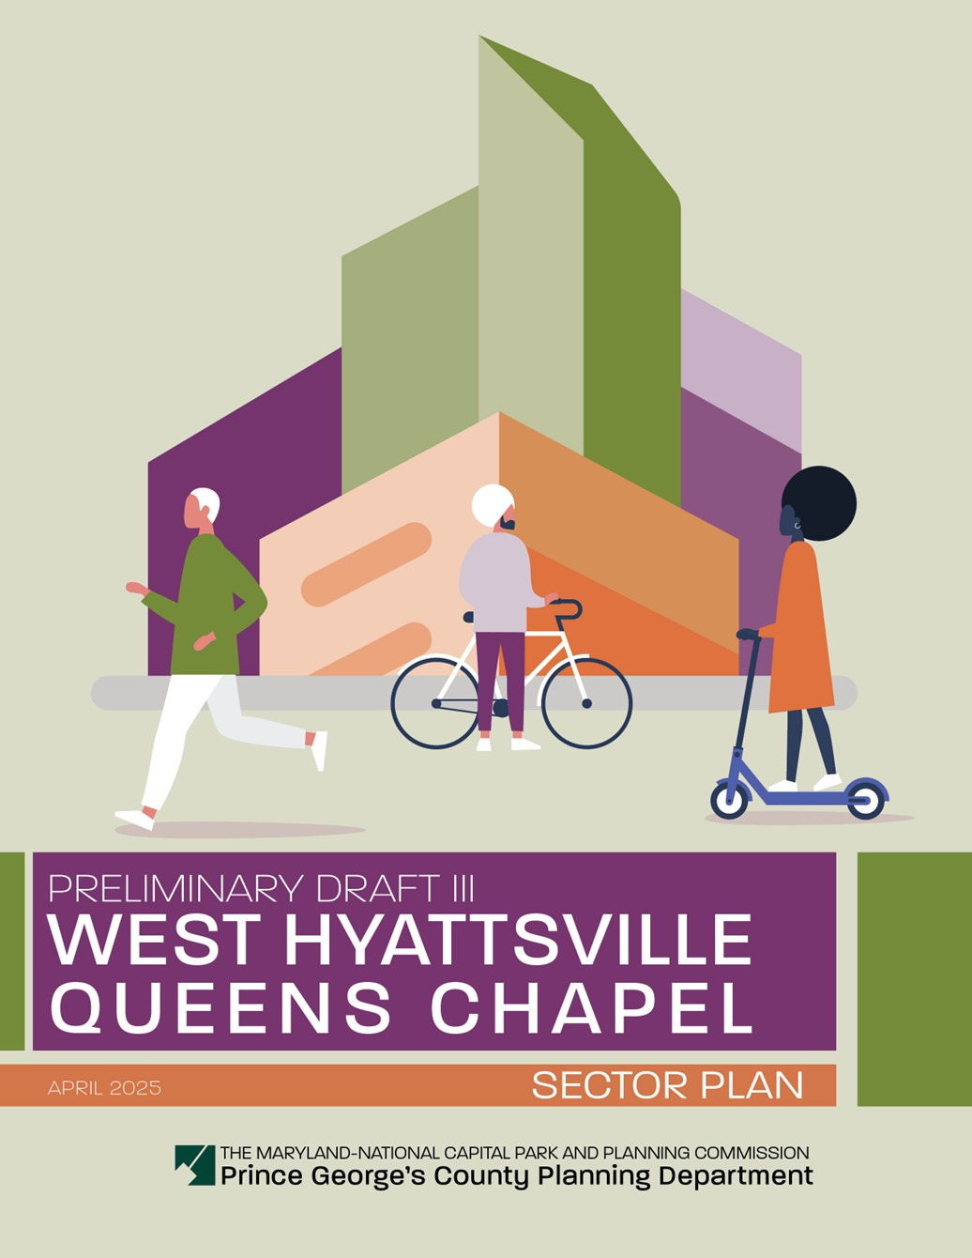
WEST HYATTSVILLE – QUEENS CHAPEL SECTOR PLAN AND SECTIONAL MAP AMENDMENT
Planning Board Work Session
September 11, 2025
Sarah Benton, AICP
Supervisor,
Long-Range Planning
Section
Thomas Lester
Planner IV,
Master Plans & Studies Section
Justin Thornton
Planner II,
Master Plans & Studies Section

Slide 2
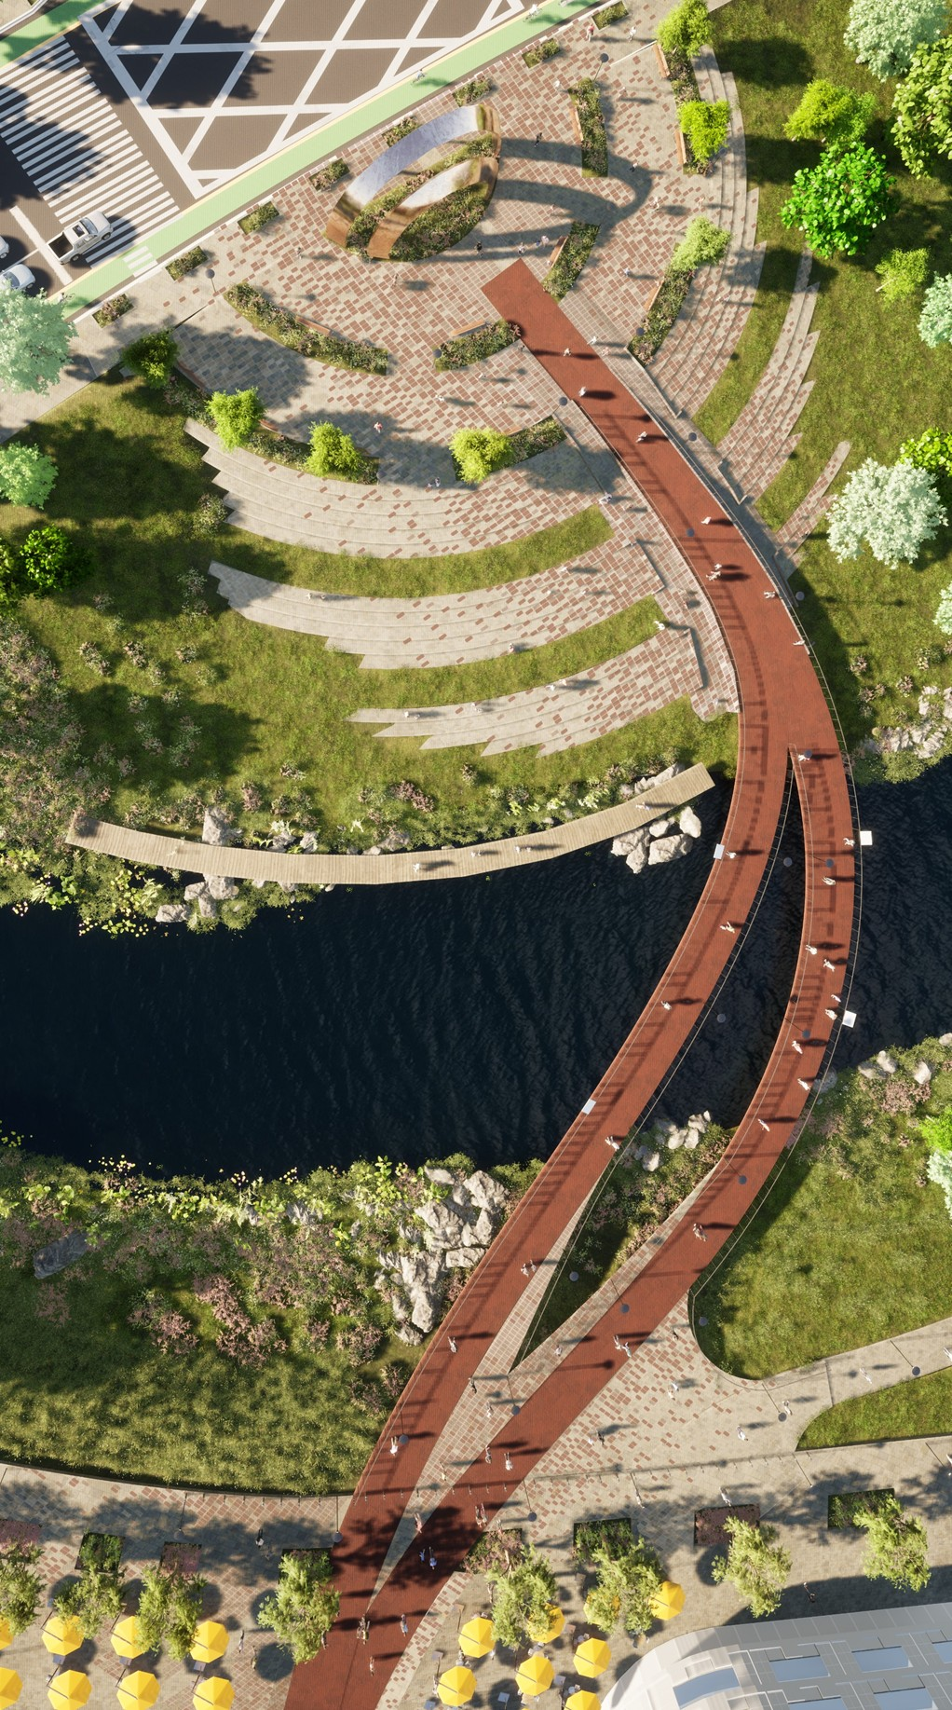
AGENDA
Background
Staff Recommended Changes
Schedule

Slide 3
BACKGROUND
Date | Event
January 9, 2025 | Planning Board remanded second draft Sector Plan and Proposed SMA back to staff for revision
April 24, 2025 | Permission to Print
July 1, 2025 | Joint Public Hearing (third draft)
September 9, 2025 | Public Facilities Resolution Approved by District Council
September 11, 2025 | Planning Board Work Session - Decision
*This process is administered under Section 27-3502 and 27-3503 of the Prince George’s County Zoning Ordinance.
Page 3 of 21

Slide 4
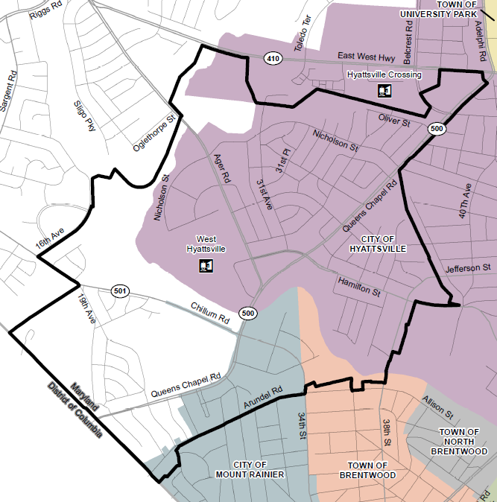
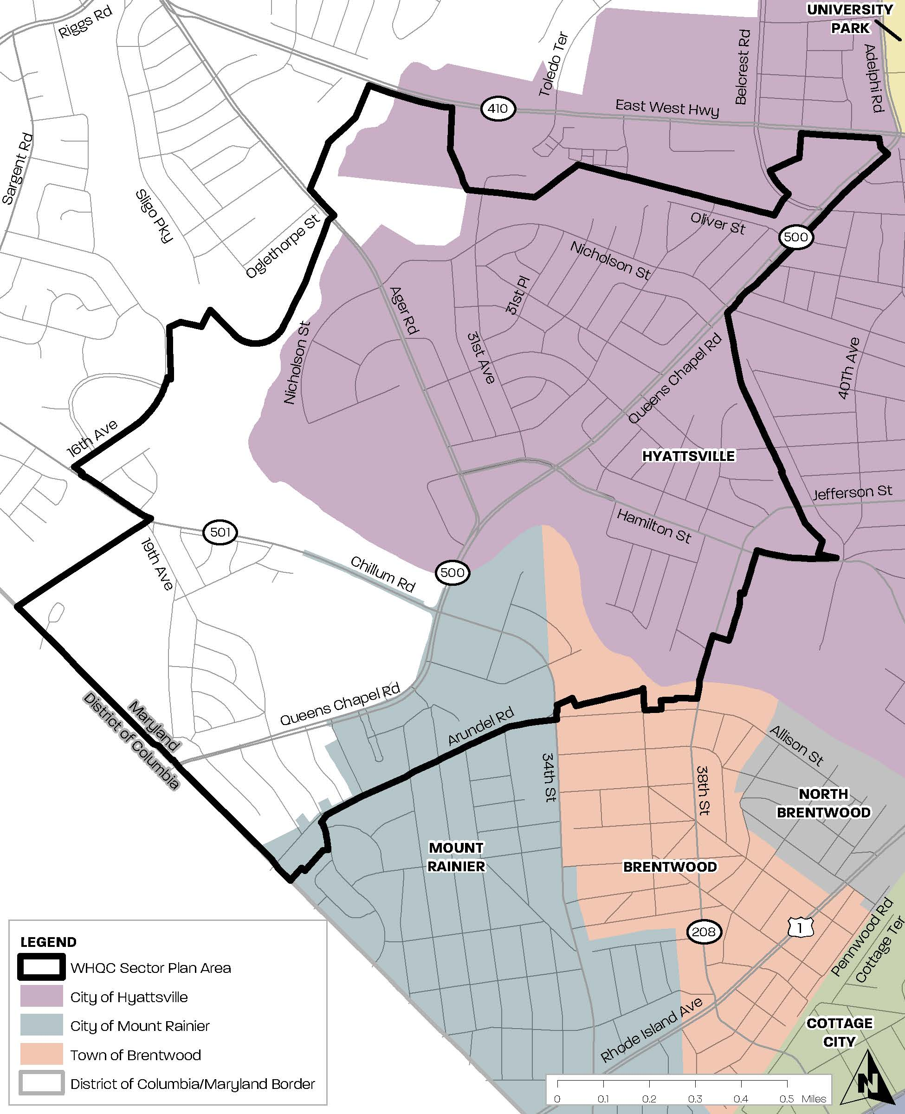
SECTOR
PLAN AREA
Mostly within Planning Area 68
Entirely within Councilmanic District 2
Includes portions of the City of Hyattsville, Mt Rainier, and Town of Brentwood
Northern boundary: Prince George’s Plaza Regional Transit District
Southern boundary: Washington, D.C.
Surrounds the 2006 West Hyattsville TDDP boundary
Page 4 of 21

Slide 5
TESTIMONY RECAP
Overview
14 speakers, 91 written testimonies received which includes 5 late submissions
Key Issues Received
Mixed feedback on rezoning RSF-65 to RSF-A: supporters note Metro access and tax growth; opponents cite broad concerns
Washington Gas requests the reclassification of its property at 2130 Chillum Road to the Industrial, Employment (IE) Zone.
General Testimony
Strong support for comprehensive plan to expand housing, improve walk/bike access, and strengthen Metro connections.
Concern that outreach overlooked established homeowners most affected, focusing instead on newer or outside residents.
Page 5 of 21

Slide 6
LATE TESTIMONY
Overview
5 late submissions
  T-1. Jeff Ulysse, City Planner for the City of Hyattsville: Email and letter in support of plan with recommendations
  T-2. Avondale North Woodridge/Pat Padua: Email in opposition to plan for Avondale/North Woodridge Community with 2-page petition
  T-3. Anne Powell: Email in opposition to plan for Avondale/North Woodridge
  T-4. Prince George’s County Health Department: Letter in support of plan
  T-5. Kevin Stephen, DCAO, GITE, Prince George’s County Government Office of the County Executive: Letter in support of plan with recommendations from DPW&T
Staff recommend admitting T1, T4, and T5 into the record. Should the Planning Board determine to allow the additional late testimony into the record pursuant to Section 27-3502(f)(3) of the Zoning Ordinance, staff have incorporated recommendations based on that testimony into the analysis of testimony and the draft resolutions of adoption and endorsement.
Page 6 of 21

Slide 7
STAFF RECOMMENDED
CHANGES OVERVIEW
SUMMARY
Recommended changes to plan elements:
  Land Use/Zoning
  Economic Prosperity
  Transportation and Mobility
  Natural Environment
  Housing and Neighborhoods
  Community Heritage, Culture, and Design
  Public Facilities
No changes to these plan elements:
  Healthy Communities
Page 7 of 21

Slide 8

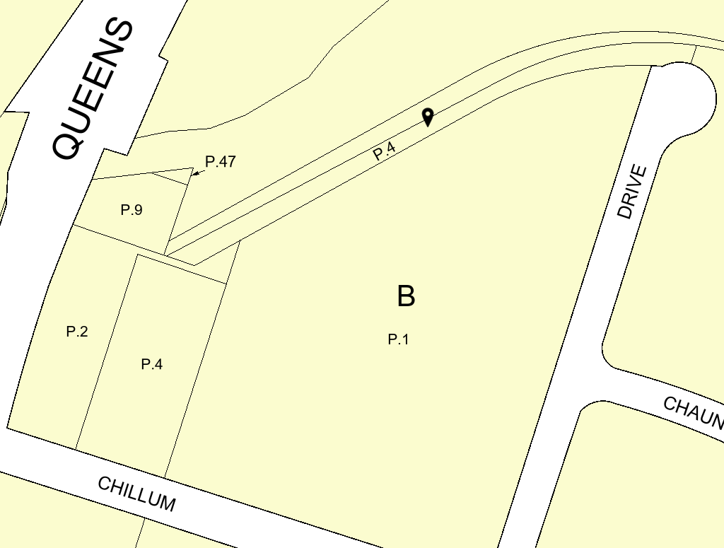
LAND USE & ZONING
Staff’s Recommendation:
Add the property located at 3301 Chillum Road (Parcel 4, Tax ID 1839505) to Zoning Change 10 (ZC 10) in the SMA to rezone to LTO-C.
Justification:
To avoid a functional split zoning of a property and aid in future redevelopment of the Queenstown Apartment complex as one cohesive property.
Page 8 of 21

Slide 9
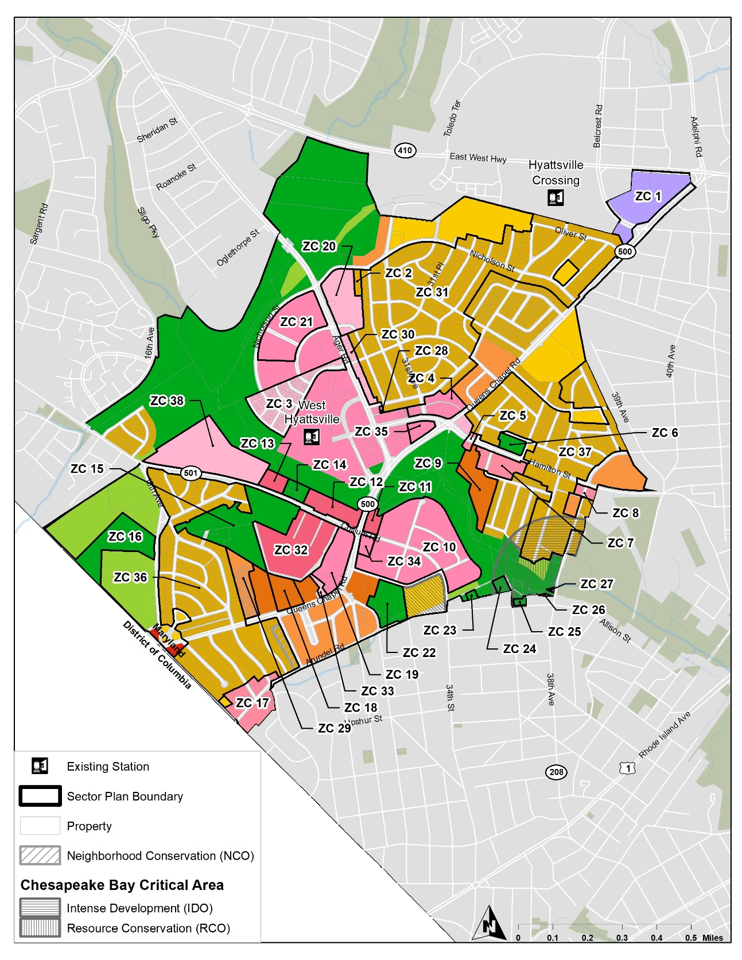
LAND USE & ZONING
Staff’s Recommendation:
Delete LU 10.3 in the sector plan and Zoning Changes ZC 31, ZC 36, and ZC 37 in the SMA, which recommended and implemented the rezoning of nearly all RSF-65 properties to RSF-A.
Justification:
Rezoning should wait until the Missing Middle Housing Study and early ADU program results provide additional guidance on implementing housing diversity within stable SFD neighborhoods.
Page 9 of 21

Slide 10
TRANSPORTATION & MOBILITY
Staff’s Recommendation:
Update/Edit Existing Conditions section
Add intro to complete and green streets
Add callbox for East Coast Greenway
Justification:
Provides additional context for recommendations
Page 10 of 21

Slide 11
TRANSPORTATION & MOBILITY
Staff’s Recommendation:
Add feasibility language to several transportation policies as requested by SHA for policies TM 1.15, TM 5.10, TM 5.13, TM 6.1, TM 8.1, TM 8.2, and TM 8.4.
Justification:
Adding feasibility language ensures transportation policies emphasize that certain recommended transportation improvements require additional study by SHA prior to implementation.
Page 11 of 21

Slide 12
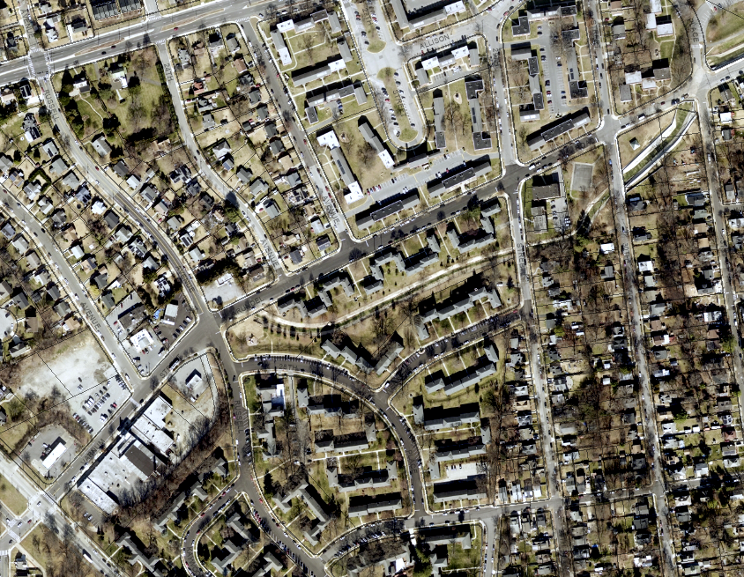
TRANSPORTATION & MOBILITY
Staff’s Recommendation:
Add Varnum Street/Arundel Road (UC-254) to TM 3.1 for retrofitting with Green Street infrastructure.
Justification:
Adds UC-254 to TM 3.1 to support its green street reconstruction and coordinate with Mount Rainier’s Safe Streets For All (SS4A) safety improvements.
Page 12 of 21

Slide 13
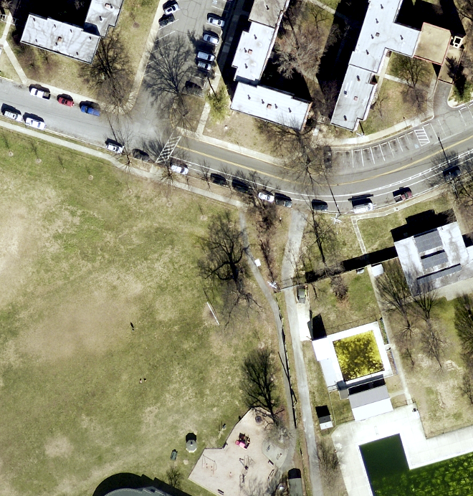
TRANSPORTATION & MOBILITY
Staff’s Recommendation:
Add TM 4.14 to create a link between trail T-209 and the UC-251 bike lane by extending the trail, to the bike lane
Justification:
Closes a key gap in the bike network by connecting the trail behind the Nature Center to the Buchanan Street bike lane, improving safety and access.
Page 13 of 21

Slide 14
TRANSPORTATION & MOBILITY
Staff’s Recommendation:
Add the following intersections to TM 8.3 for intersection enhancements.
  Varnum Street/Arundel Road and Russell Street
  25th Avenue and Queens Chapel Road
  25th Avenue and Arundel Road
  30th Street and Arundel Road
  Chauncey Place and Queenstown Drive
Justification:
Reinforces action items in the 2023 City of Mount Rainier Vision Zero Action Plan
Page 14 of 21

Slide 15
TRANSPORTATION & MOBILITY
Staff’s Recommendation:
Add TM 8.5 to implement automated speed enforcement (ASE) within the City of Mount Rainier; targeting Queens Chapel Road, Varnum Street, 25th Avenue, 27th Avenue, 30th Street, Buchanan Street, and Chillum Road.
Justification:
Reinforces action items in the 2023 City of Mount Rainier Vision Zero Action Plan
Page 15 of 21

Slide 16
TRANSPORTATION & MOBILITY
Staff’s Recommendation:
Add TM 8.6 Implement Mount Rainier gateway treatments, such as curb extensions, signage, landscaping, pavement color, etc., to help reduce speeds as people enter the City of Mount Rainier; specifically at Chillum Road south of Queens Chapel Road, and Varnum Street east of Eastern Avenue (See HD 1.9).
Add HD 1.9 Design and construct gateway features at Chillum Road south of Queens Chapel Road and Varnum Street east of Eastern Avenue to mark entry into the City of Mount Rainier. These gateways should incorporate public art and signage that express the City’s unique identity, and design elements that calm traffic (See TM 8.6).
Justification:
Reinforces action items in the 2023 City of Mount Rainier Vision Zero Action Plan
Page 16 of 21

Slide 17
HOUSING & NEIGHBORHOODS
Staff’s Recommendation:
Add HN 2.6 Evaluate the adequacy of existing public facilities to meet the needs of new housing development and ensure continued service provision for existing housing.
Justification:
Emphasizes the existing residents’ desires to ensure adequate public facilities are met as housing increases.
Page 17 of 21

Slide 18
HOUSING & NEIGHBORHOODS
Staff’s Recommendation:
Add HN 2.11 Utilize Prince George’s County’s right to first refusal program by allowing the Department of Housing and Community Development (DHCD) to purchase multifamily rental housing that preserves affordability for low-to-moderate income households.
Justification:
Brings attention to and encourages the use of one of the County’s most successful affordable housing programs.
Page 18 of 21

Slide 19
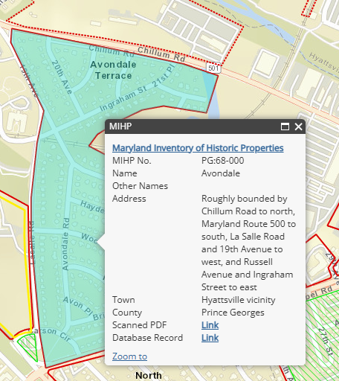
COMMUNITY HERITAGE, CULTURE & DESIGN
Staff’s Recommendation:
Add HD 6.3 Work with the County Executive Office, County Council, and Historic Preservation Section of the Prince George’s County Planning Department to determine local eligibility of the Avondale Grove and Avondale Terrace subdivisions, collectively known as Avondale (PG: 68-000), as a Historic District.
Justification:
Supports community interest in preserving Avondale’s historic character for potential designation.
Page 19 of 21

Slide 20
ANTICIPATED SCHEDULE
WINTER
2025
January 2025 – November 2025
Planning Board REMAND
Jan. 2025
January-
April 2025
Legislative Process
Permission to Print
April 24, 2025
Joint Public Hearing
July 2025
Planning Board Work Session and Action
Sep. 2025
Plan Refinement
Jan. 2025-
April 2025
Council Work Session
Oct. 2025
Council Action
Nov. 2025
Planning Process
SPRING-SUMMER 2025
FALL
2025
FALL 2025
2025
Public Release of Preliminary Plan and Proposed SMA
April 2025
*This process is administered under Section 27-3502 and 27-3503 of the Prince George’s County Zoning Ordinance.
Page 20 of 21

Slide 21



Project Facilitator:
Sarah Benton, AICP
Supervisor, Long-Range Planning Section
Community Planning Division
sarah.benton@ppd.mncppc.org
THANK YOU!
QUESTIONS?
Email us at whqc@ppd.mncppc.org
Project Manager:
Thomas Lester
Planner IV, Master Plans & Studies Section
Community Planning Division
thomas.lester@ppd.mncppc.org
Justin Thornton
Planner II, Master Plans & Studies Section
Community Planning Division
justin.thornton@ppd.mncppc.org
Page 21 of 21

